Slide 1
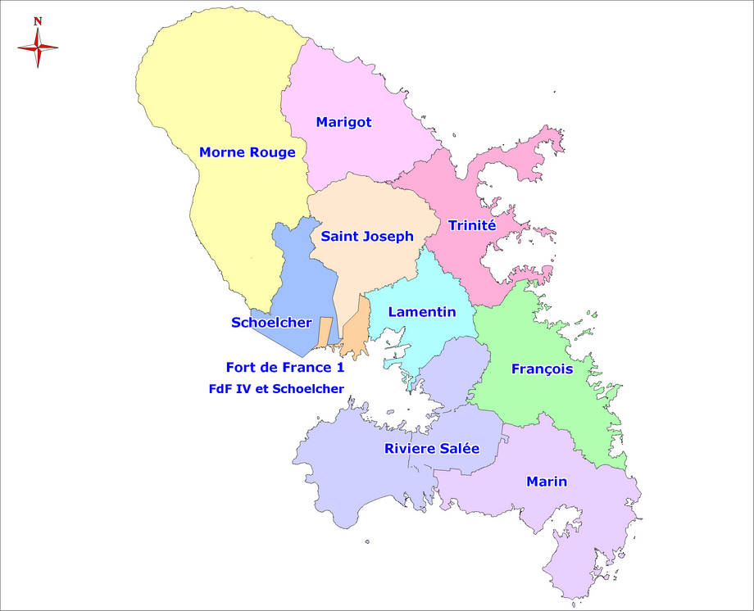
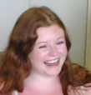

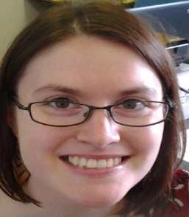
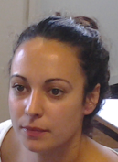
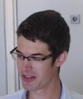


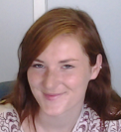
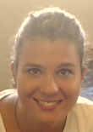
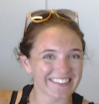
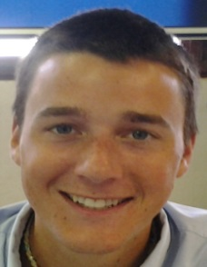
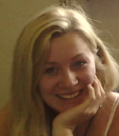
Les 12 assistants de l’académie
My name is Natasha.
Hi! My name is Spenser.
Hi! My name is Skye.
Hola! Yo soy Maria del Mar.
Hi! my name is Zach.
Hi! My name is Elizabeth.
My name is Justin.
Hello! My name is Shannon
Hi! I’m Sam.
Mi nombre es Maria Andrade Delgado.
Hello! My name is Katya.
Hi! My name is Rose.

