Slide 1

Easter in St. Lucia
(Pâques à Sainte Lucie)

Slide 2
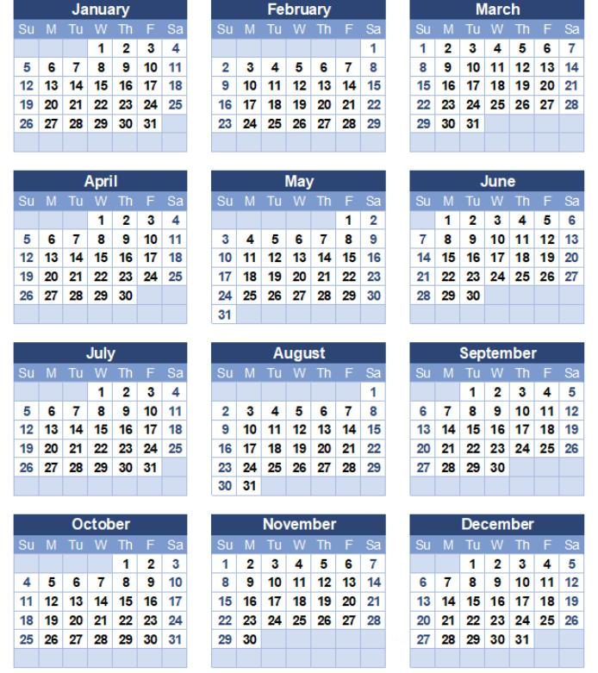

WHEN?
In Saint Lucia, Easter is in April (like the rest of the world)
This year, Easter is on Sunday, April 17th , 2022

Slide 3
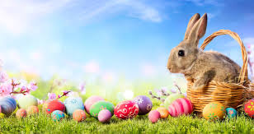
What is Easter?
Easter is one of the most awaited Christian festivals and every nation has its own way of celebrating this particular time.
What do we do?
We go to church on Good Friday. This the Friday before Easter Sunday.
We stay home and watch movies.
This year, Good Friday in Saint Lucia is on April, 15th , 2022.
Good Friday is a holiday in Saint Lucia. This means that there is no school, and no work. Everyone is at home.

Slide 4
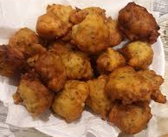
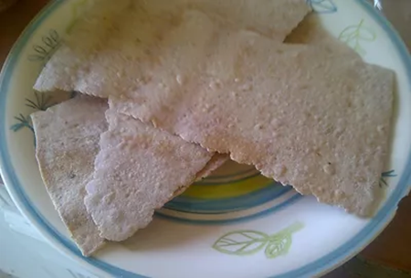
WHAT DO WE EAT?
We eat FISH CAKES (traditional appetizers on Good Friday)
It is a mixture of flour, salt, shredded saltfish, ground pepper, parsley, chives, hot pepper, baking powder and water
Fish cakes
PENEPIS
Ingredients
2 lbs flour
2 lbs brown sugar
2-4 ozs grated ginger
2 cups water
Method
1. In a pot, boil the water sugar and ginger into a thick syrup.
2. Mix the syrup with flour and grated ginger.
3. Cut the dough in pieces and roll out thinly unto a floured surface.
4. Bake in 325 degree oven until dry and brown.
We eat PENEPIS

Slide 5
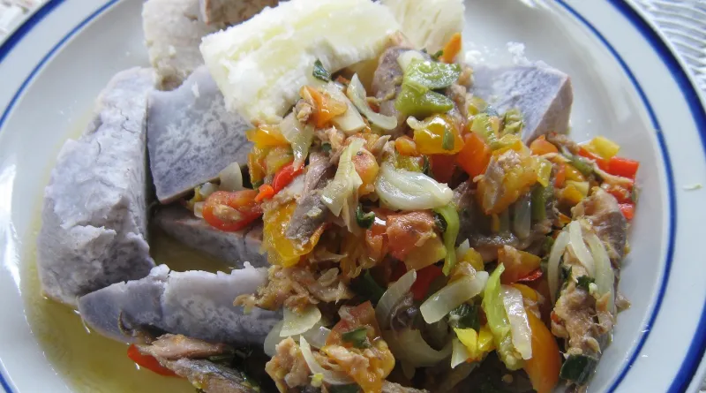
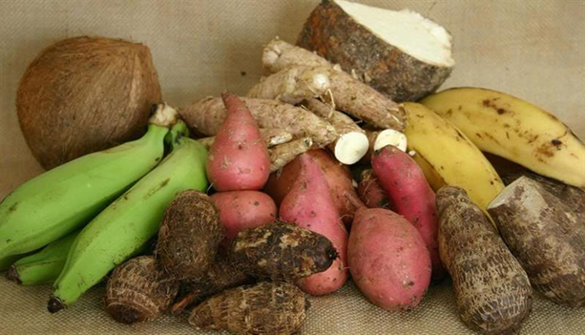
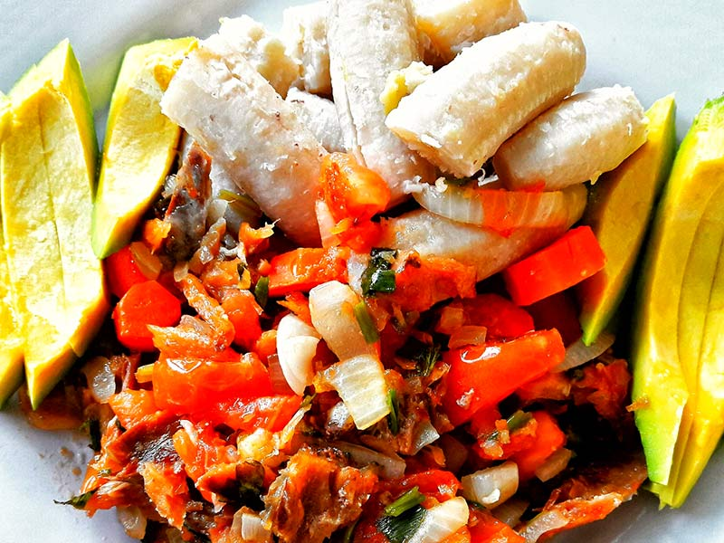
Examples of meals on Good Friday
Makrel and ground provision
Ground provisions
Vegetables and fish

Slide 6
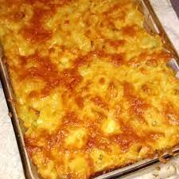
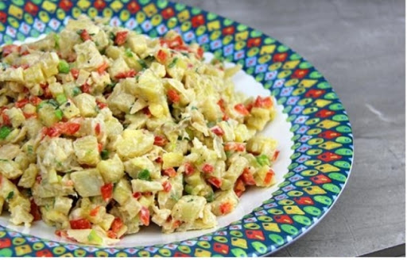
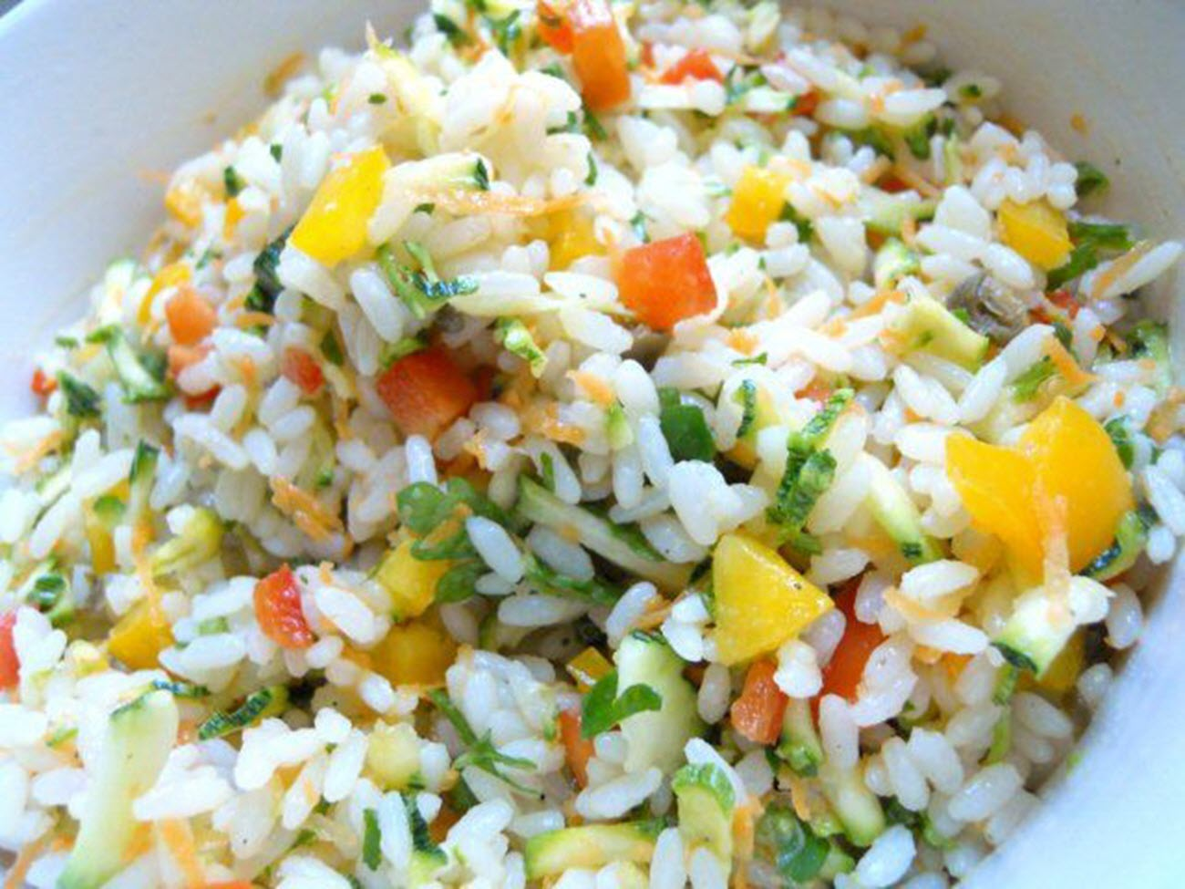
Easter Sunday: What do we cook?
Easter Sunday is celebration day: we cook large meal with a variety of meat: strew, grilled or baked and lots more.
Green fig salad
Rice salad
Macaroni pie

Slide 7
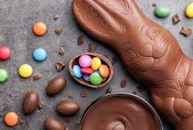
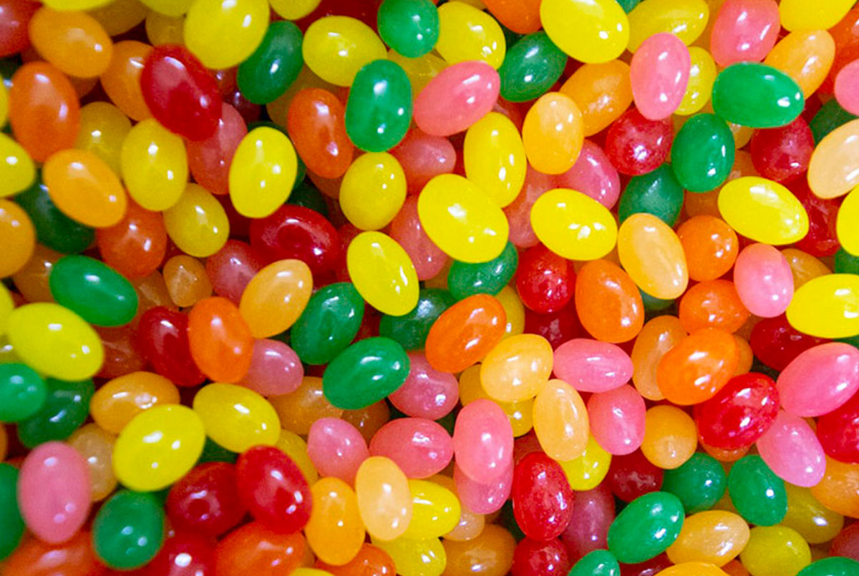
WHAT DO WE EAT?
We also eat Easter chocolate
We eat Jelly beans

Slide 8


Easter Sunday : what do we do?
Family time
Kite flying

Slide 9

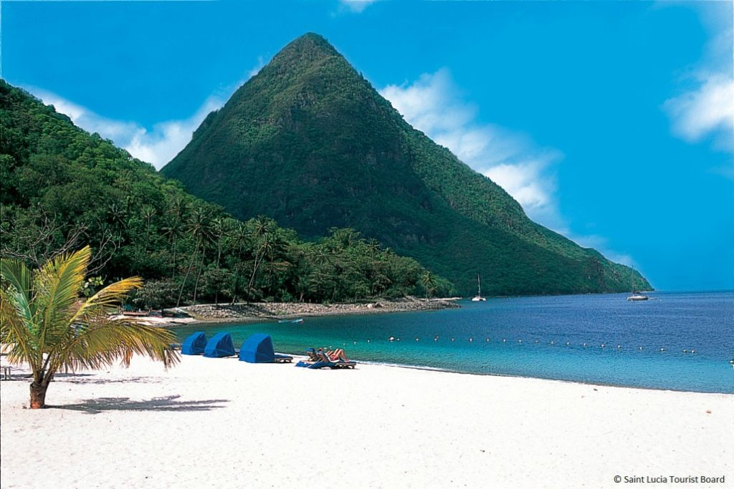

EASTER MONDAY: what do we do?
We have a picnic with the family
We go to the beach
We watch fireworks

Slide 10
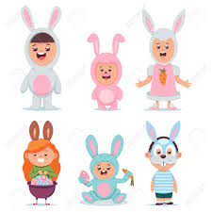

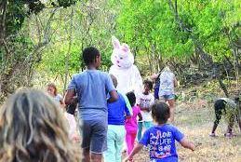
At school, we do activities with the students
They wear Easter costumes
They decorate Easter eggs
They organize Easter Eggs Hunts with Easter Bunny

