Slide 1
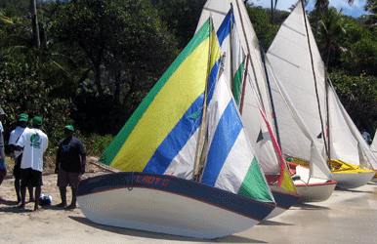
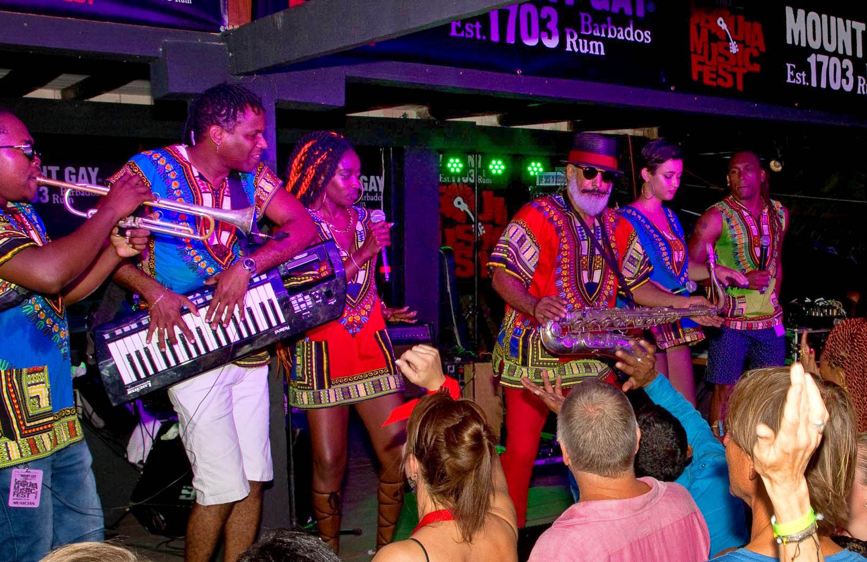
Easter in St. Vincent and the Grenadines
Mission
Langues Vivantes Etrangères 1er degré
By Jonel Cadougan

Slide 2
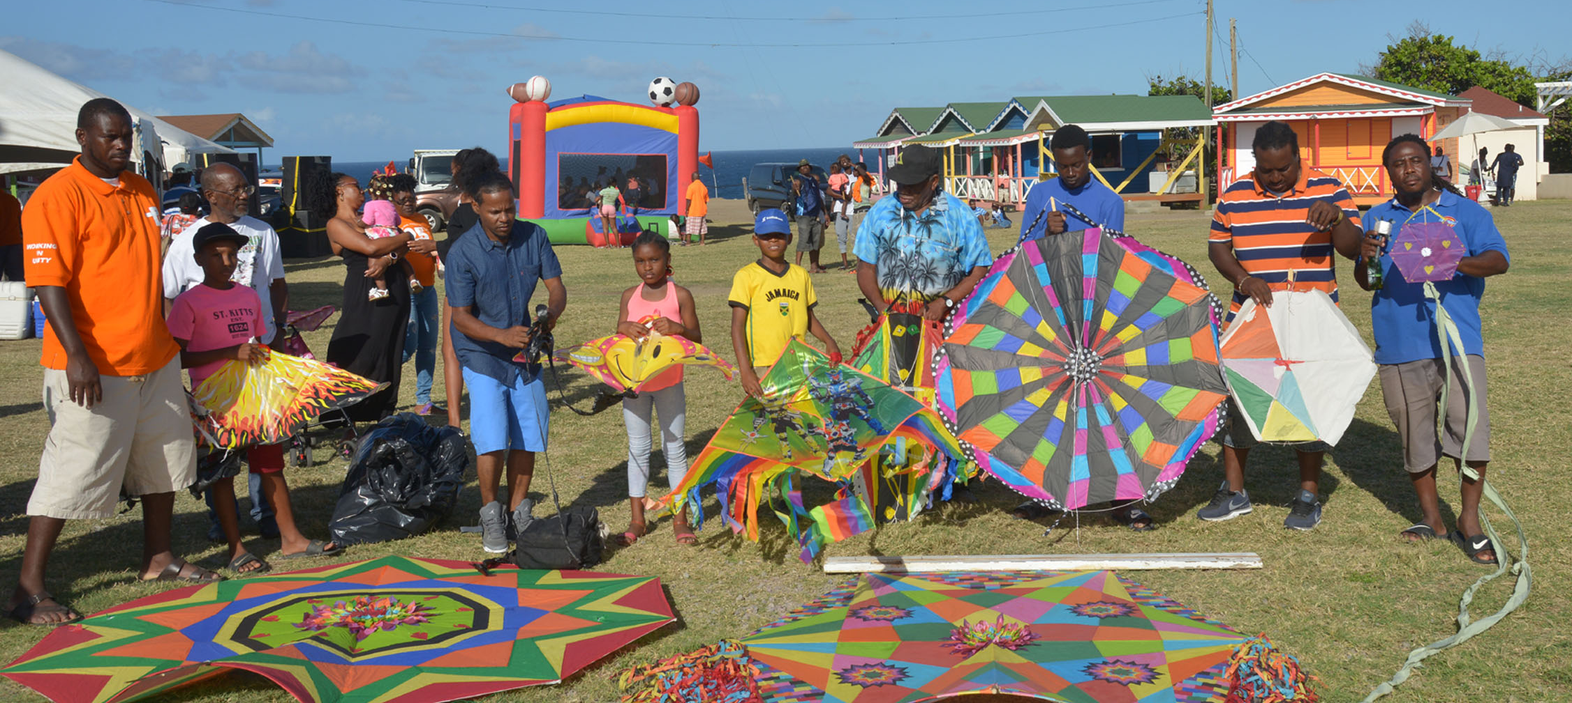
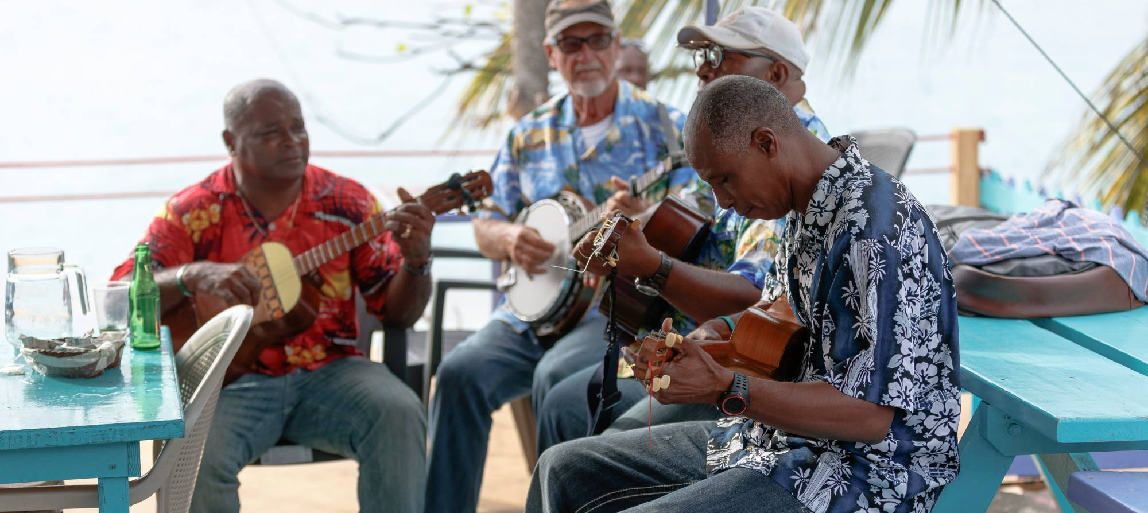
About Easter in SVG
Easter is celebrated in St. Vincent and the Grenadines during the month of April. In St. Vincent it is mostly celebrated among the religious community however there are other non-religious activities that take place. One such activity is kite flying.

Slide 3
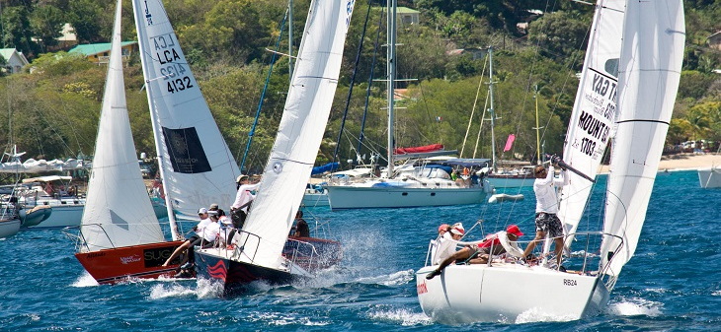

Easter Regatta and Easterval
The Bequia Regatta and the Easterval Regatta (Union Island), take place during Easter weekend every year.
The weekend activities include boat races, sports and games, calypso and many other competitions and activities.

Slide 4
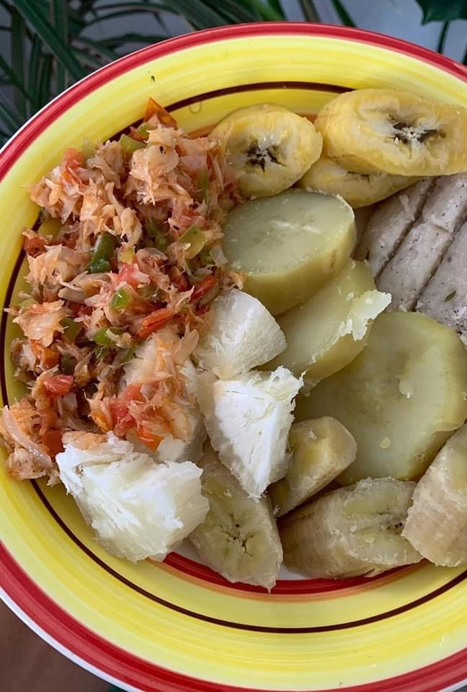
Food eaten during Easter
During Easter, Vincentians eat many locally prepared dishes. They eat saltfish (morue), Smoked herring (hareng fumé), fry fish (poisson frit) and tri tri cakes (les accras de titiris). These are eaten with ground provisions (légumes pays) and bakes (comme bokit), doughboy (un type de pain fait avec de la noix de coco) and dumpling (dombré).
There are also sweet treats such as ducana(à base de patate douce et enveloppée dans les feuilles de bananier), sweet potato pudding (le pudding aux patates douces), and hot cross buns (un petit pain au sucré avec une croix sur le dessus).

Slide 5
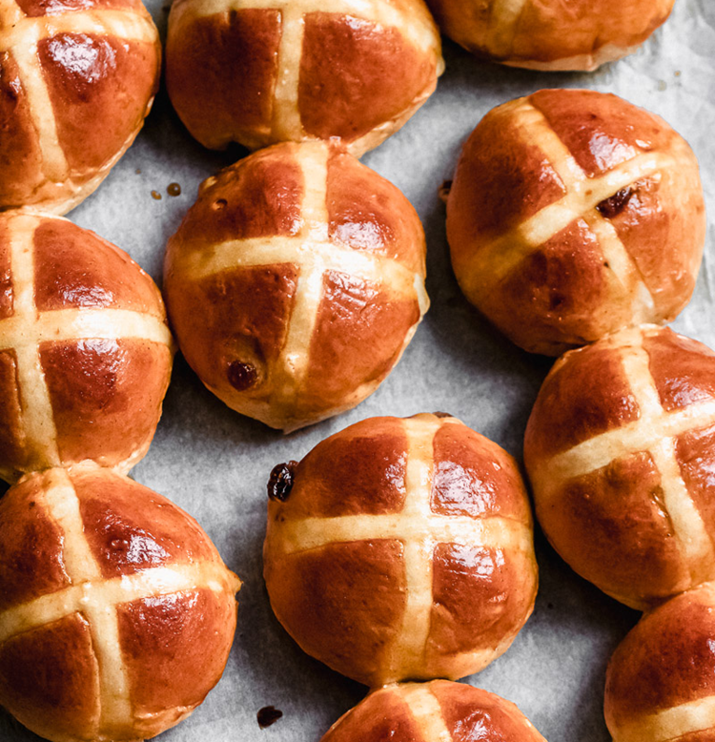
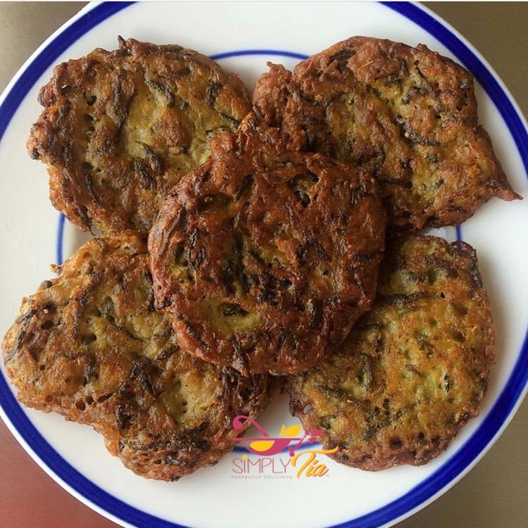
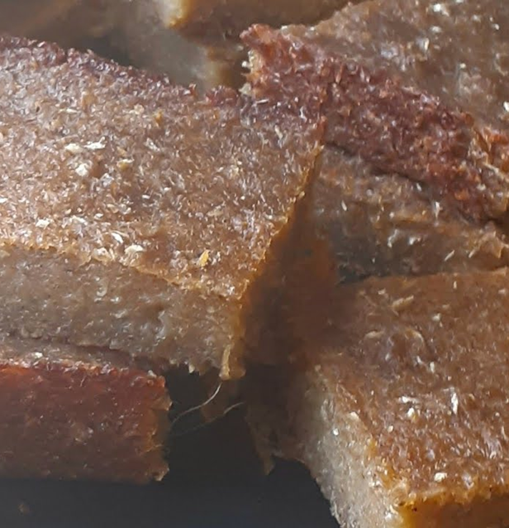
Photos

