Slide 1
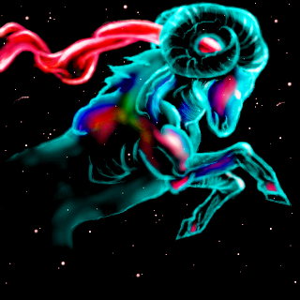
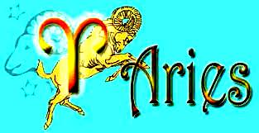
Work / Carrer : Heat :
Aries can get promotion Aries are neither energetic nor agree for without lots of stress. anything.
You just need to be watchful You SHOULD better calm yourself for a better day. to the opportunitys.
Love : Luck :
Either you can attract Lucky colour : red people for yourself or you can have everything you want, but for that, stay with your friends you have to be more quiet and watchful. and have a whale of a time.
From 21st March to 20th April
Daily horoscope by Samuel L.

