Slide 1


HERE IS THE PREPARATION FOR DONUTS

Slide 2
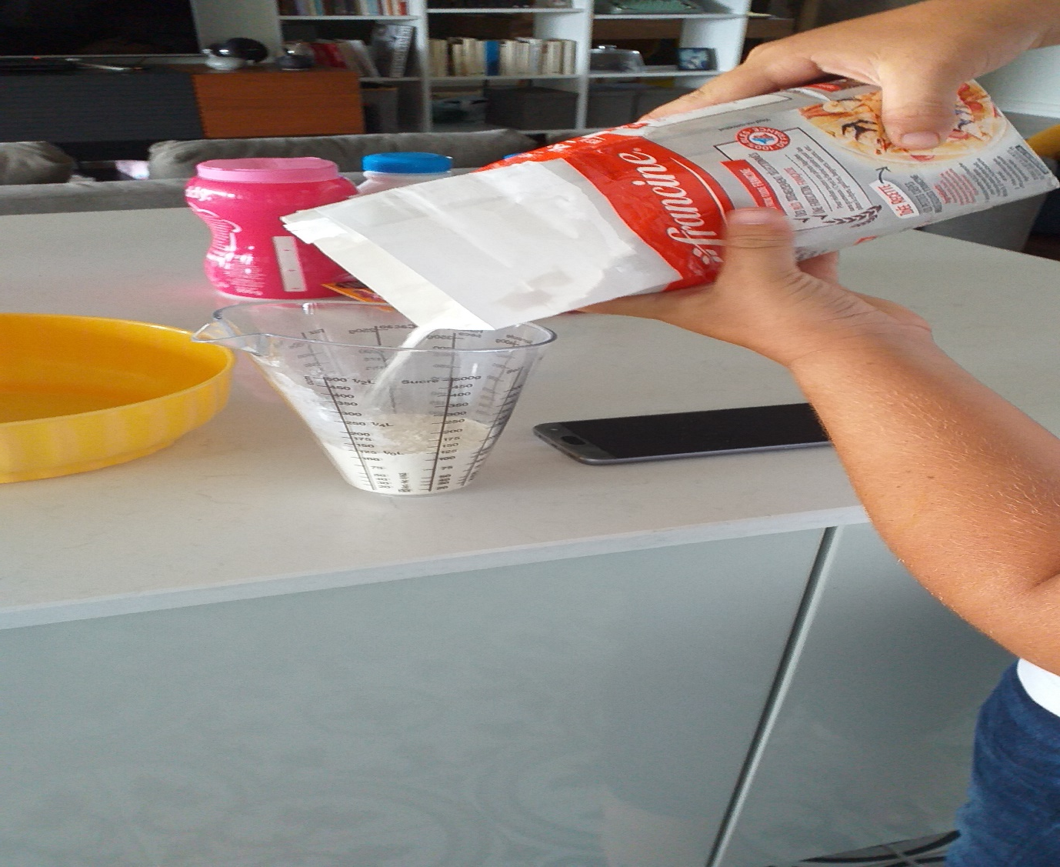
FIRST OF ALL TO START BY PUTTING 1KG OF FLOUR IN THE SALAD BOWL

Slide 3
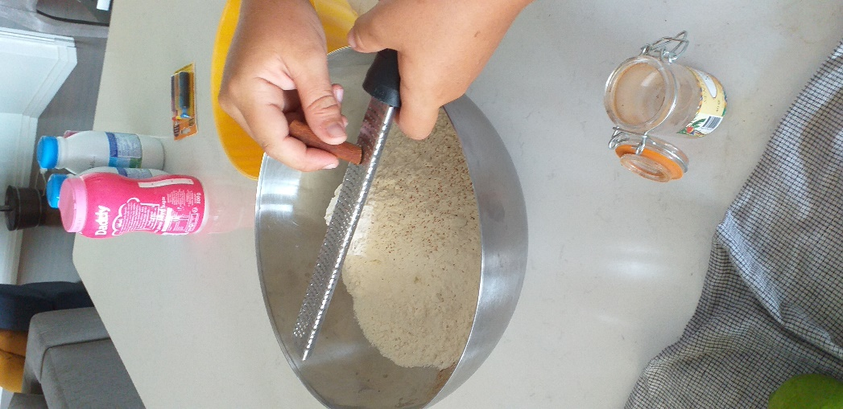
THEN WE’LL DO A BIT OF CINNAMON

Slide 4
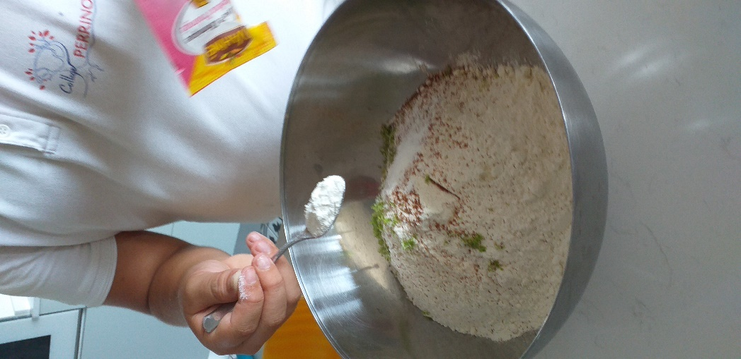
WE WILL ALSO ADD 4 TEASPOONS OF VEAST

Slide 5
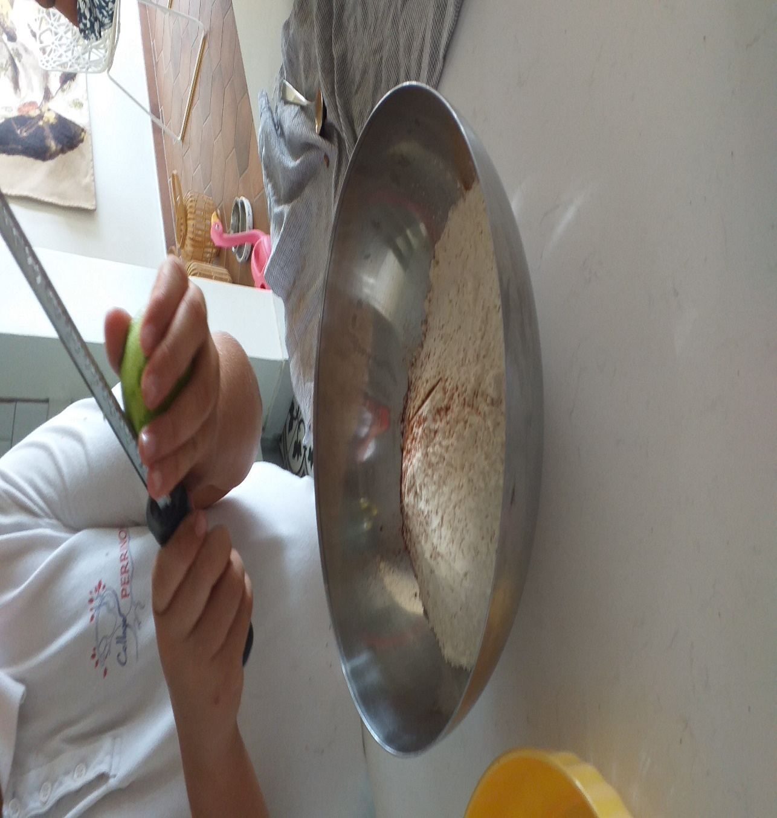
AND WE WILL ALSO RAP LEMON

Slide 6
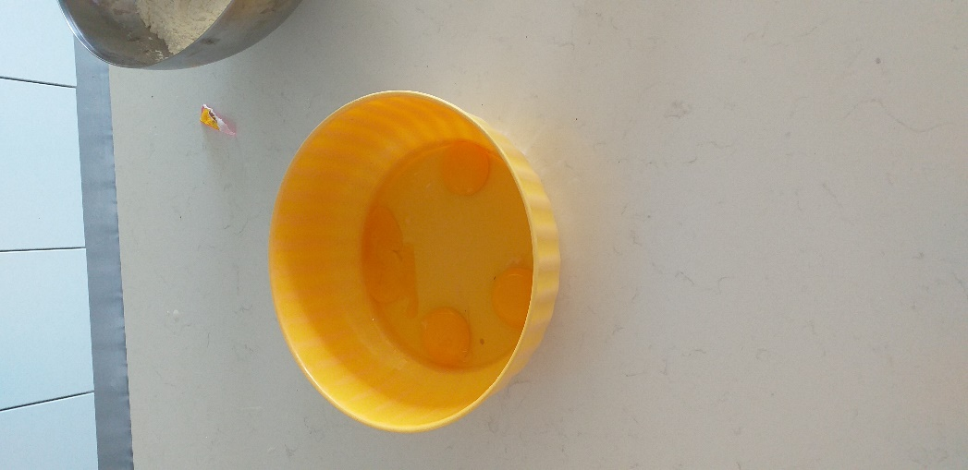
THEN IN ANOTHER BOWL, WE WILL MIX 4 EGGS

Slide 7
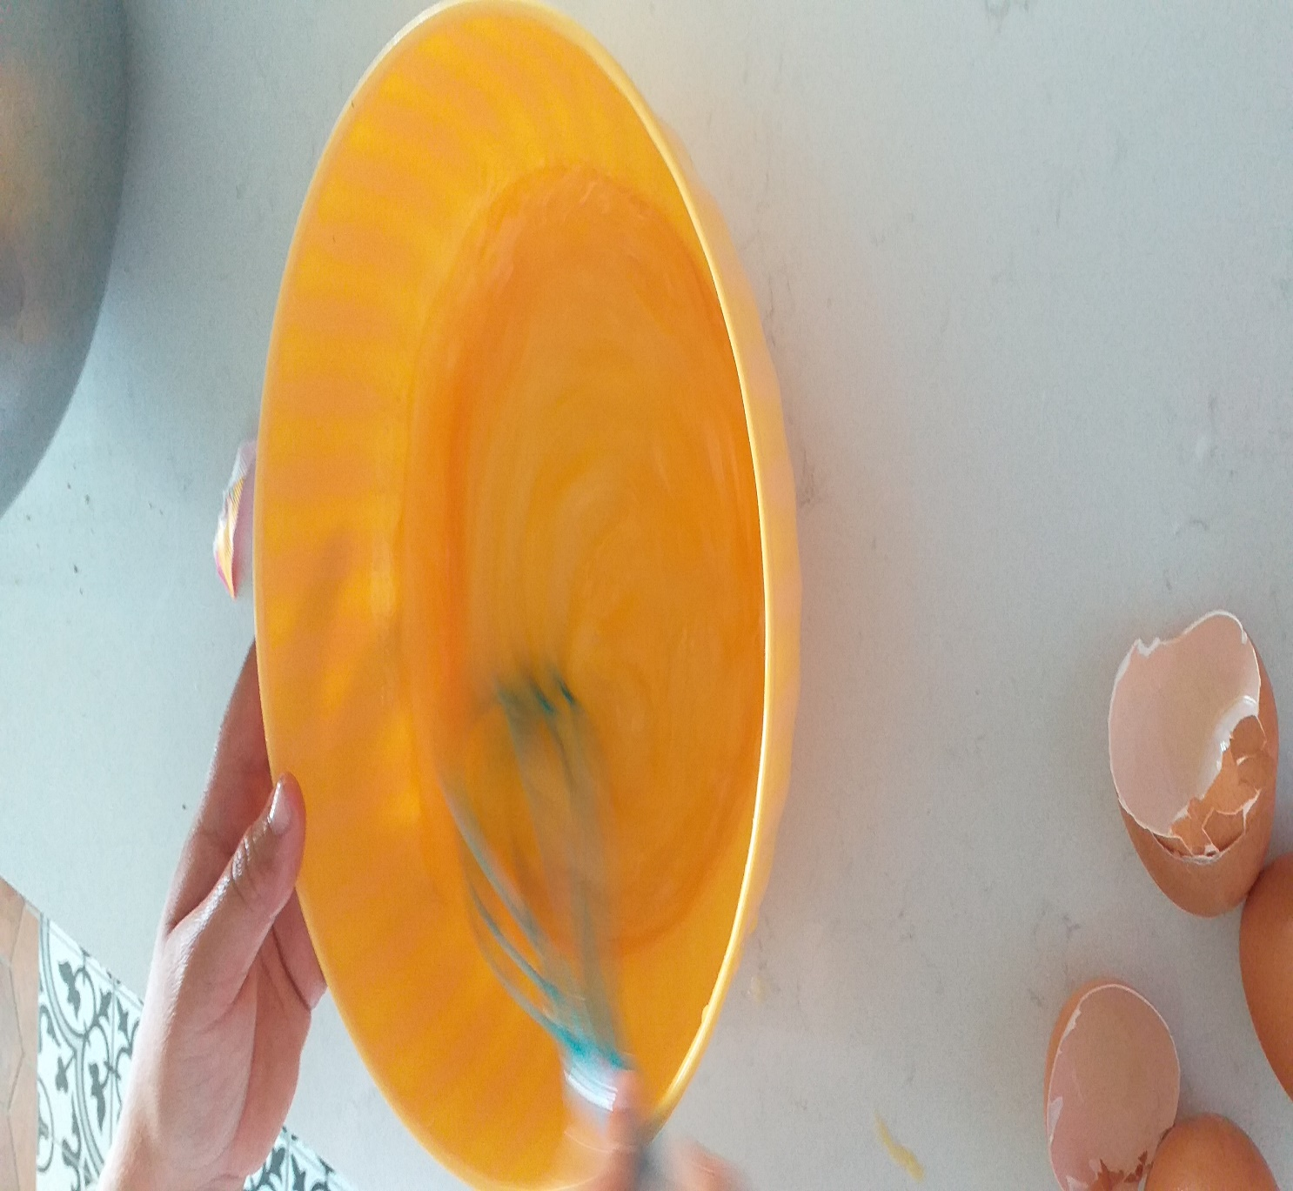

Slide 8
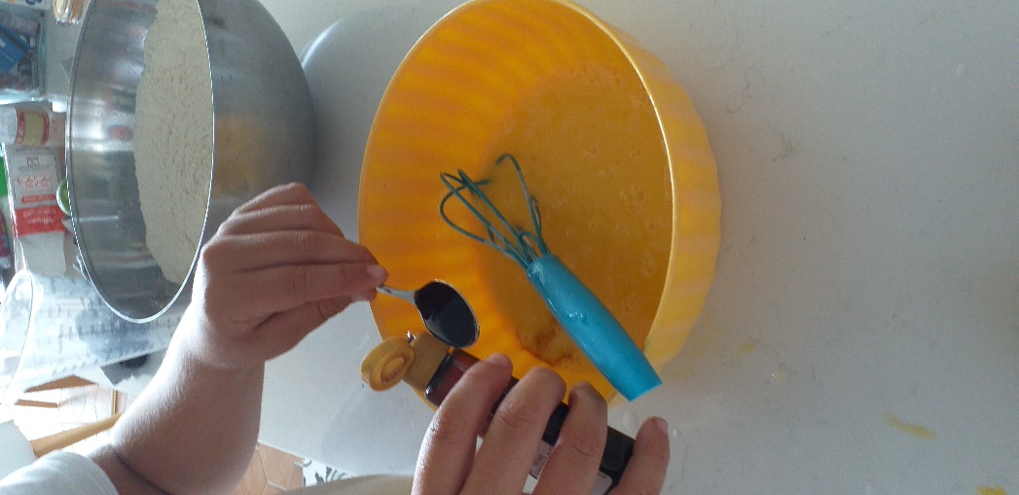
THEN AFTER MIXING THE EGGS WELL, WE WILL ADD VANILLA

Slide 9
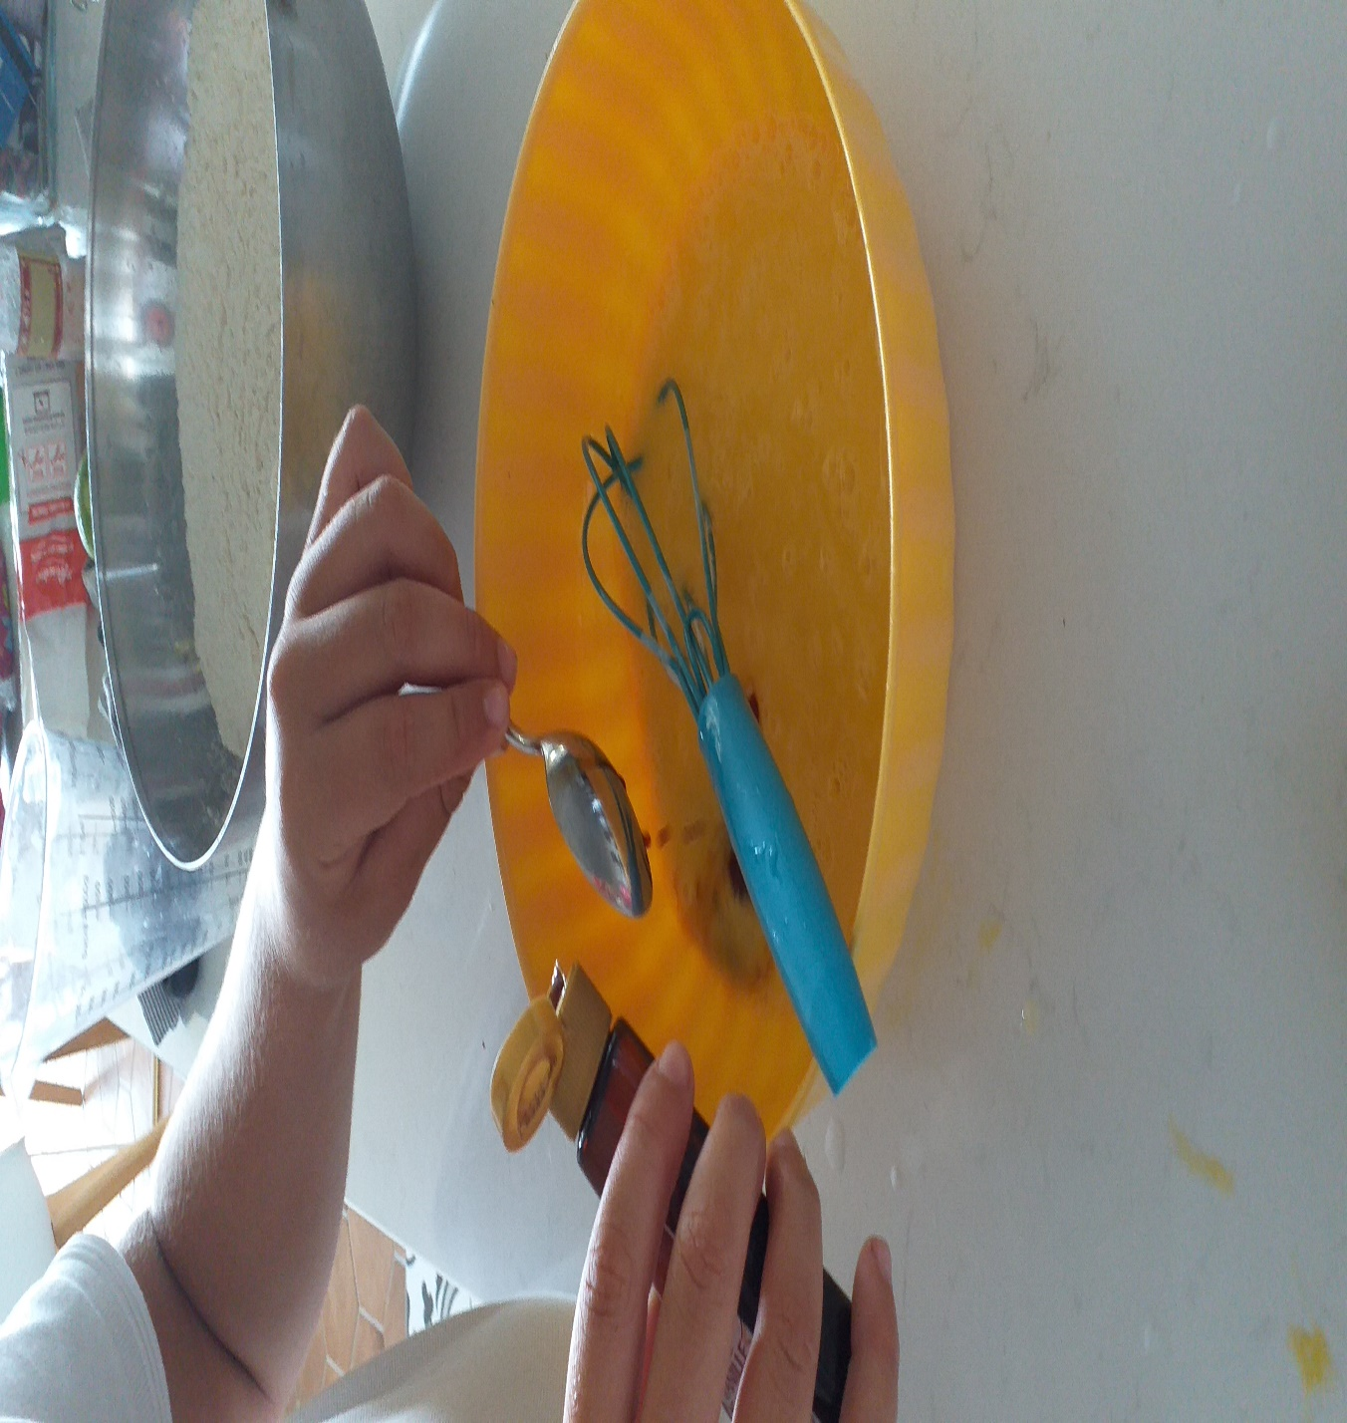

Slide 10
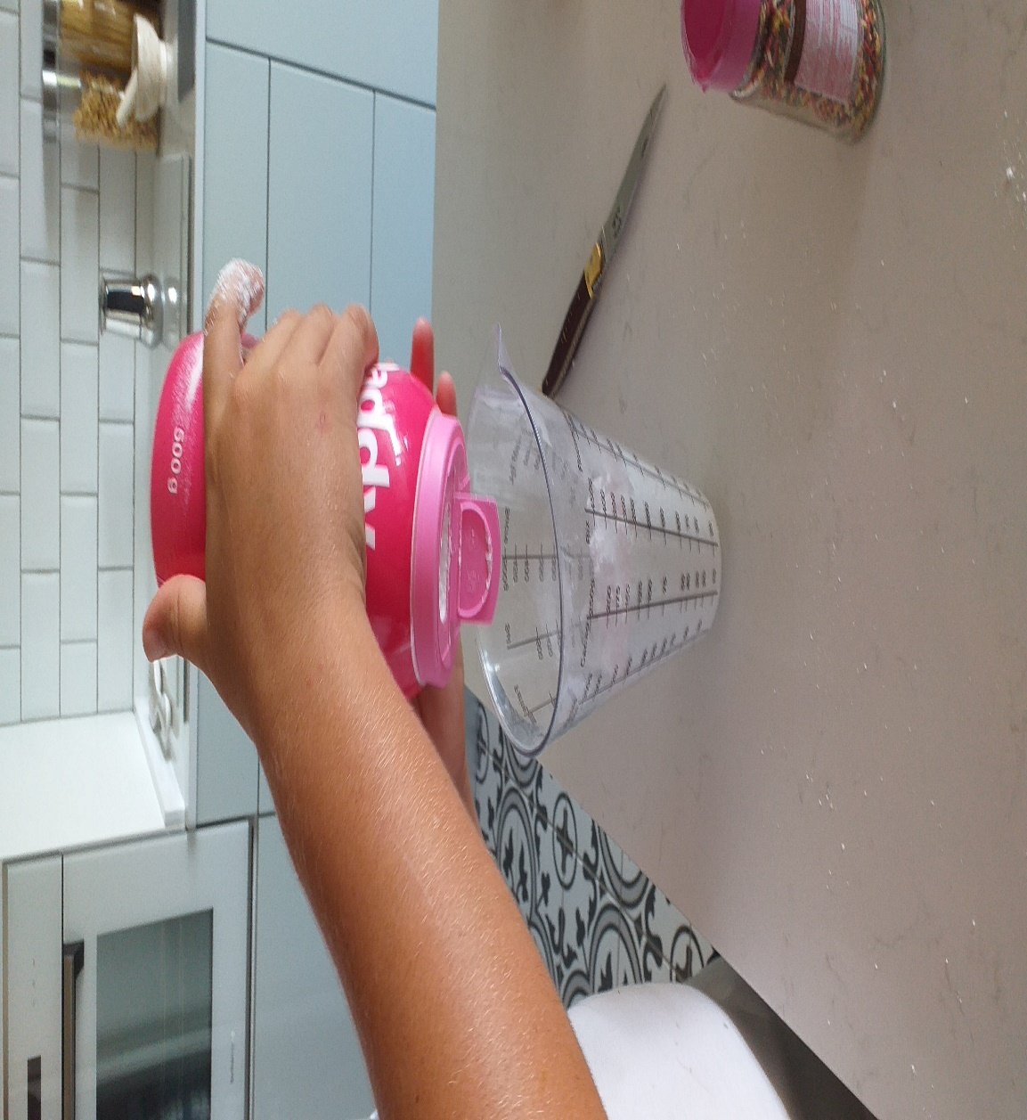
THEN WE WILL ADD SUGGAR

Slide 11
THEN WE WILL MIX UNTIL THE MIXTURE BECOMES THICK

Slide 12
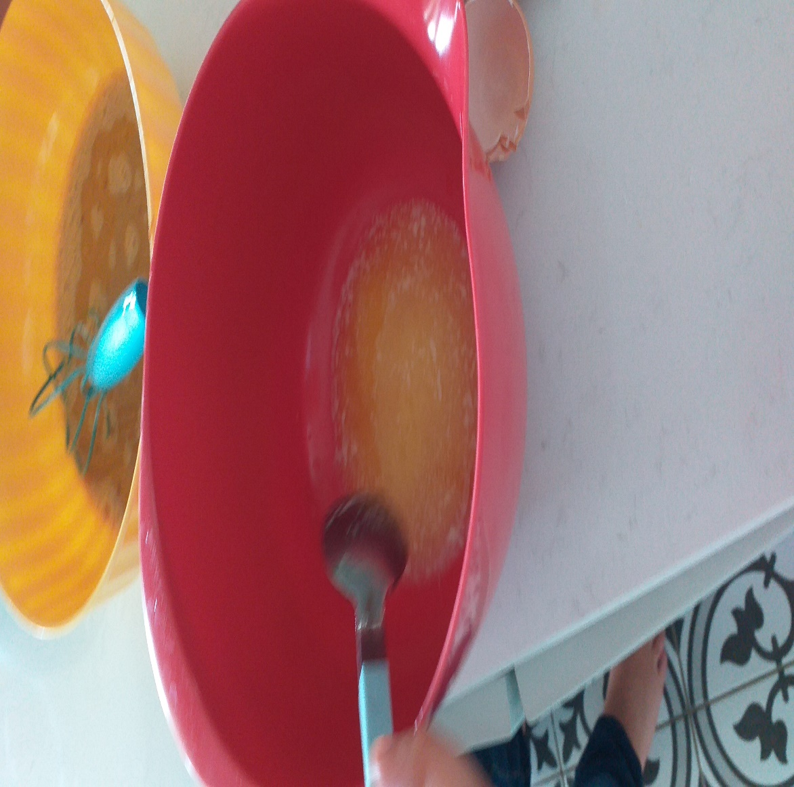
THEN IT WILL BE NECESSARY IN ANOTHER BOWL TO MIX THE MELTED BUTTER WITH THE MILK

Slide 13
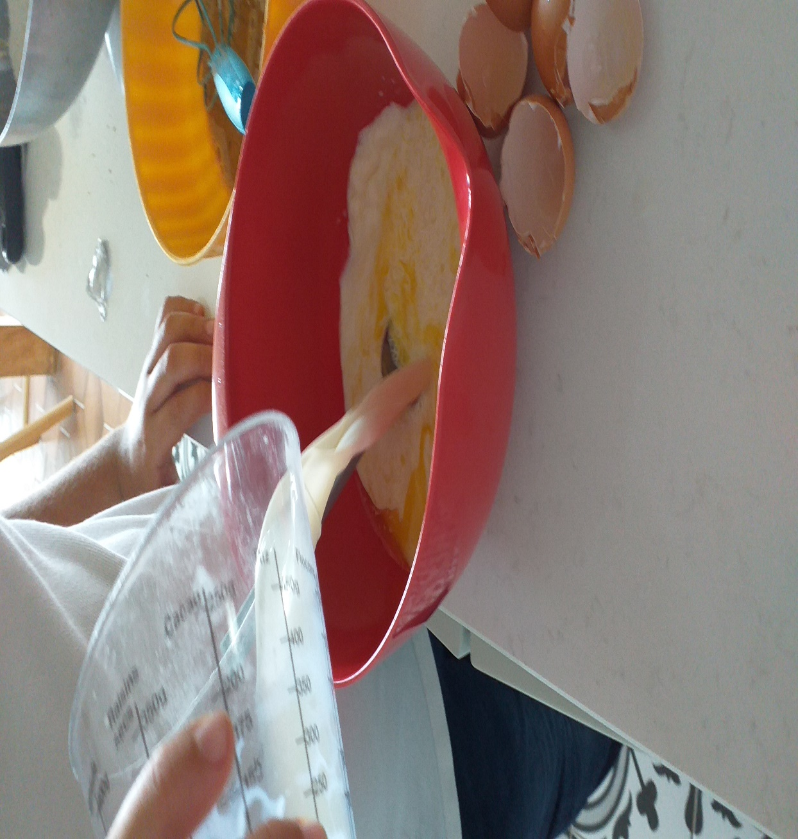

Slide 14
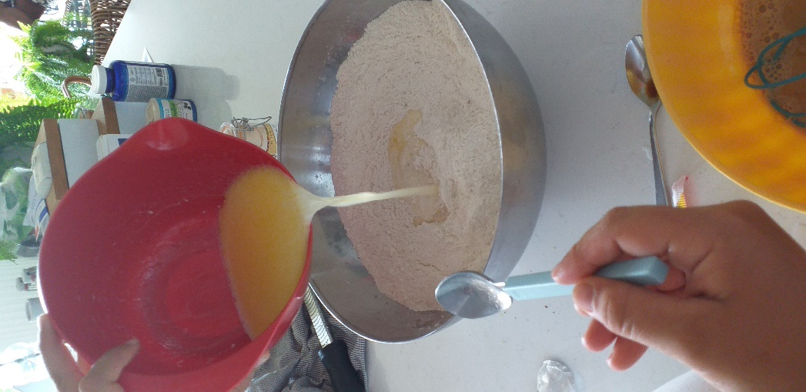
THEN AFTER, WE WILL MIX EVERYTHING

Slide 15
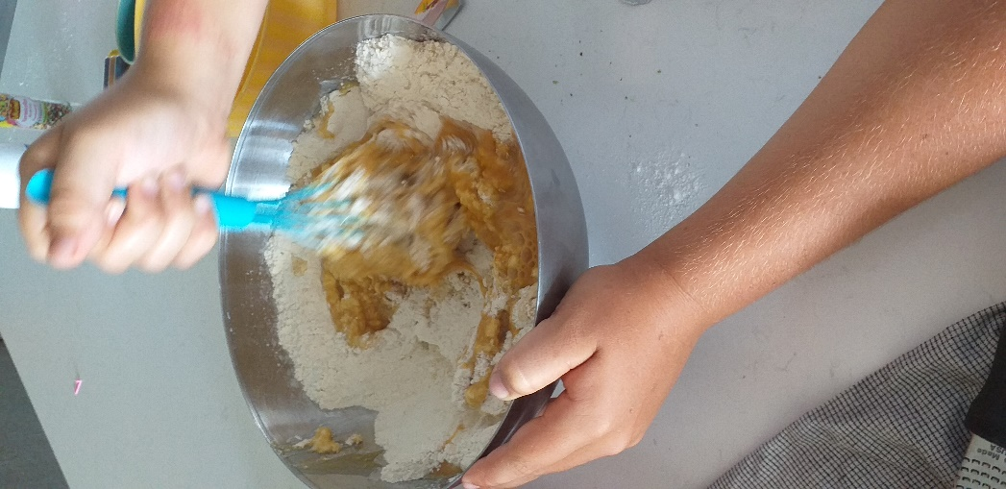

Slide 16
THEN COVER AND LEAVE THE DOUGH FOR 2 HOURS IN THE REFRIGERATOR

Slide 17
THEN WHEN THE 2 HOURS HAVE PASSED, ON A FLOURED BOARD, SPREAD THE DOUGH ON A THICKNESS OF ABOUT 1CM. CUT THE DONUT WITH A BOWL OR ORTHER

Slide 18
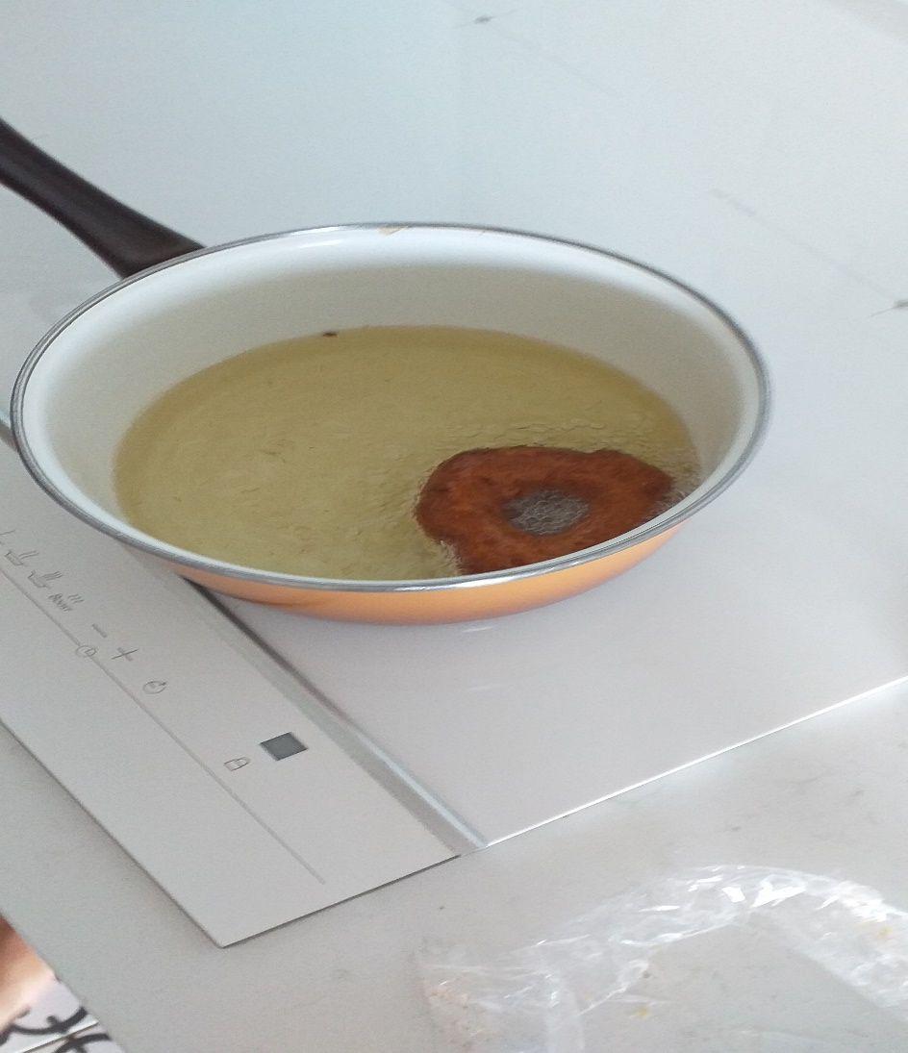
THEN FRY FOR 1 MINUTES UNTIL GOLDEN THEN RETURNED AND LEAVE A MINUTE MORE

Slide 19
PUT ON AN ABSORBENT PAPER WHEN IT’S COOKED

Slide 20
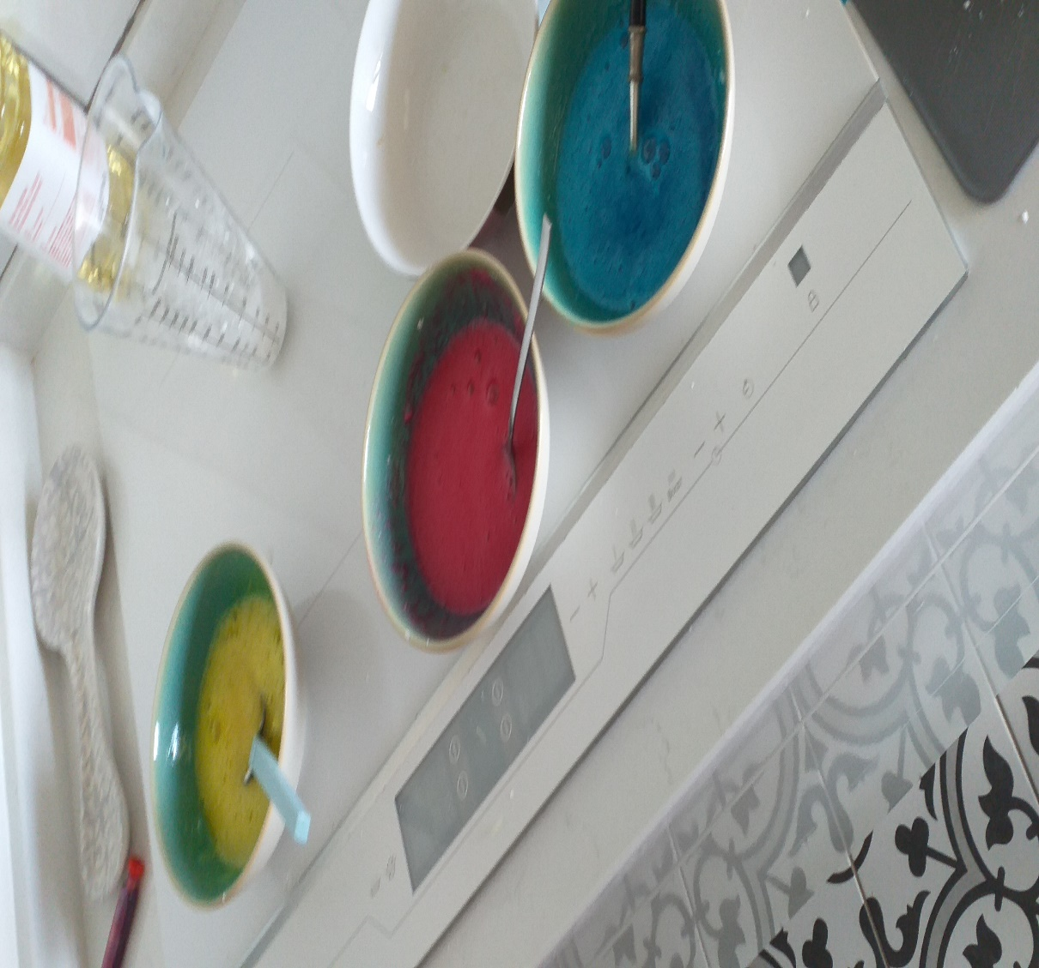
THEN TO MAKE THE ICING, PUT IN A BOWL 200G ICING SUGAR, 1 EGG WHITE AND A LEMON JUICE AND THE DVES AND MIX EVERYTHING

Slide 21
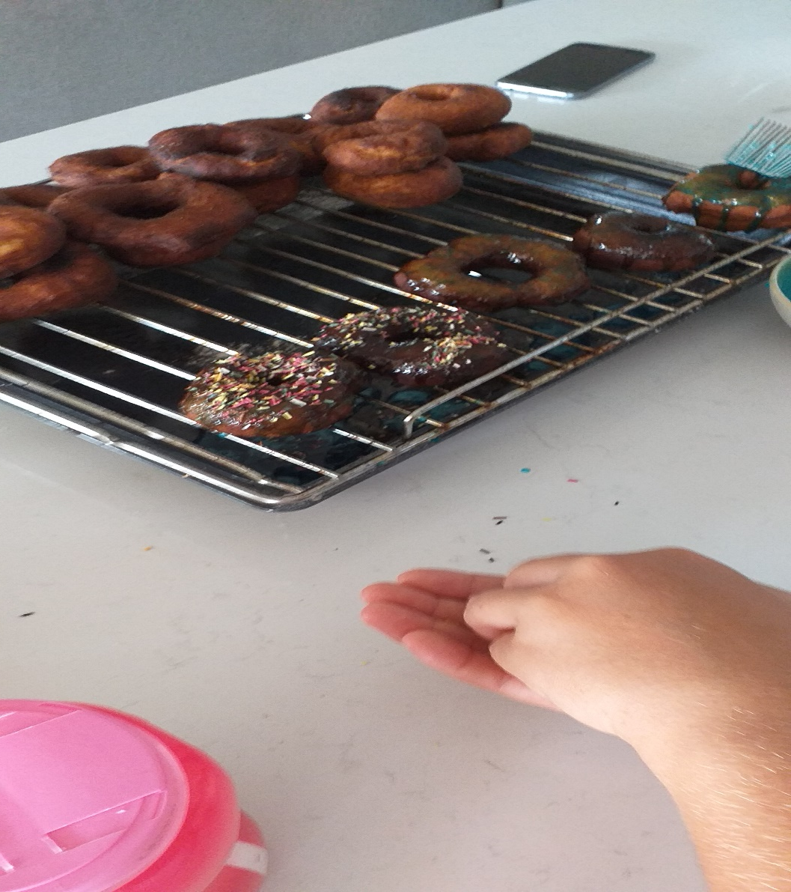
POUR THE ICING ON THE DONUTS AND THE VERMICELLI AND HERE IT IS READY !!

Slide 22
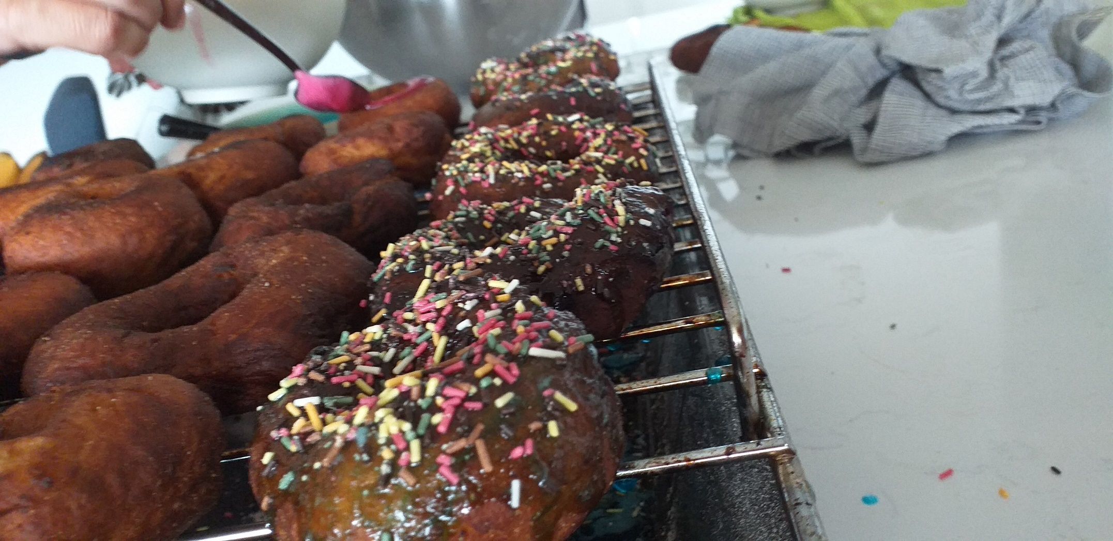

Slide 23
THE END
BY CHARLES SHARICK
AND LEPORE PAOLO
5°5
4 HOURS OF PREPARATION

