Slide 1


Presentation of the Carbet secondary school
(Martinique)
Erasmus+ project
« Local Food, Global Change 2014/2016 »
Strategic partnership with Liceul Teoretic « Onisifor Ghibu » in Sibiu (Romania) and Liceo Camillo Golgi in Breno (Italy)

Slide 2
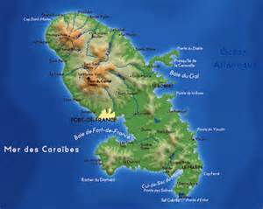
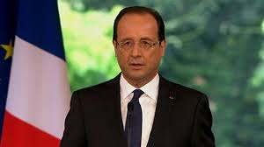
Martinique
Martinique is an outermost region of the European Union and an overseas department of France.
La Martinique est une région ultrapériphérique européenne et un département d’outremer de la France.
                The French president is François Hollande.
                Le président français est François Hollande.

Slide 3
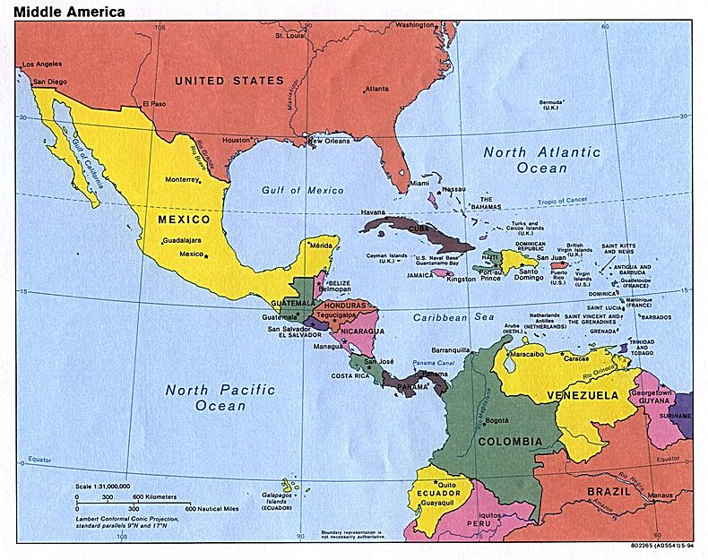
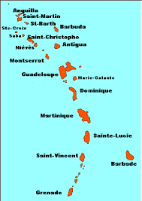
Where is Martinique?
The arc of the Lesser West Indies
                Martinique is an island that is in the south of Dominica and in the north of St. Lucia.
                Martinique est une île située au nord de la Dominique et au sud de Sainte-Lucie.

Slide 4
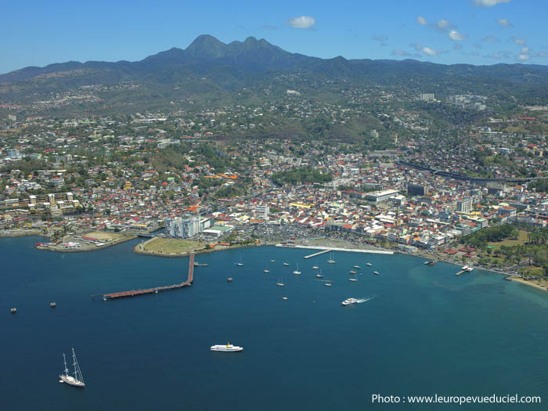
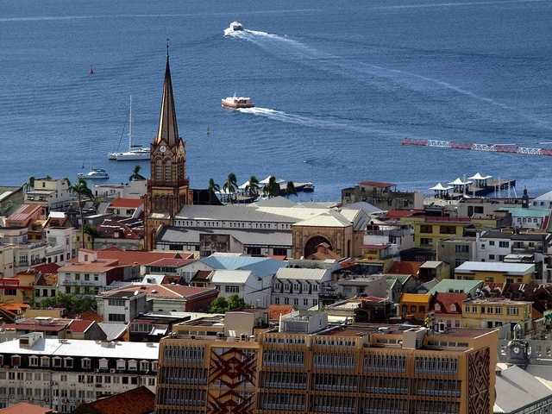
A few figures
                The capital city is Fort-de -France.
                La capitale est Fort-de-France.
                There are about 387 000 inhabitants in Martinique.
                Il y a environ 387 000 habitants à la Martinique.
                People speak French and créole and the main religion is catholicism.
                Le français et le créole sont les langues principales. La population est généralement catholique.

Slide 5
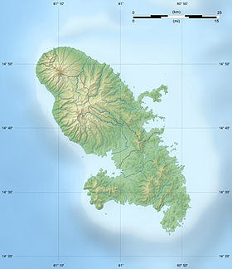
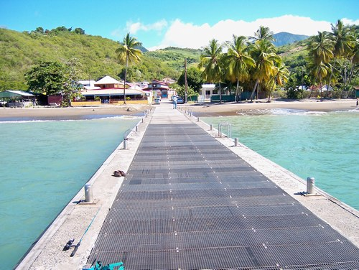
Where is Carbet ?
Le Carbet est au nord de la Martinique sur la côte Caraïbe.
Carbet is in the North of Martinique on the Caribbean coast.
Au Carbet, il y a 3809 habitants appelés les Carbétiens et Carbétiennes.
Carbet has 3809 inhabitants called Carbetians.
Le Carbet

Slide 6
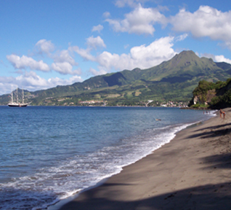
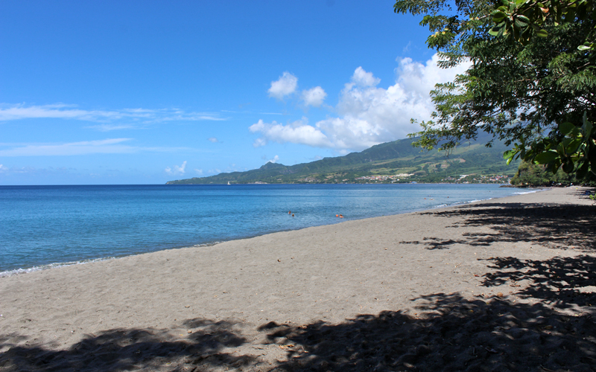
A little bit of history
Christophe Colomb découvrit l’île de la Martinique en 1502 au cours de son quatrième voyage. Il débarqua au Carbet, sur la plage de Anse Turin.
Christopher Colombus discovered the island of Martinique in 1502 during his fourth voyage . He disembarked in Carbet , on the beach of Turin bay.

Slide 7

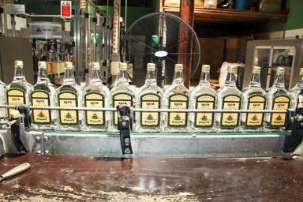
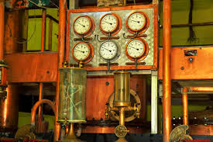
Carbet farm products
Au Carbet, il y a la célèbre distillerie Neisson. Par son goût unique, ce rhum blanc agricole est considéré comme l’un des meilleurs au monde.
In Carbet, there is the famous Neisson distillery. By its unique taste, this white rum is considered as one of the best in the world.

Slide 8
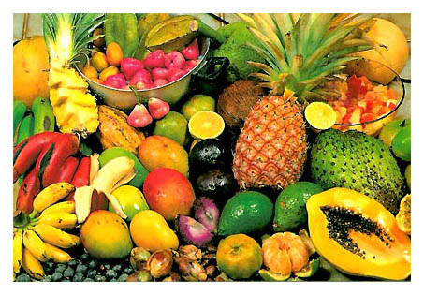
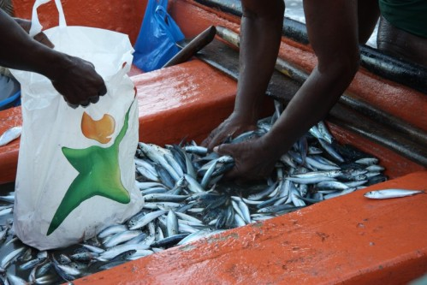
Fruit, vegetables and fish
*Au Carbet, il y a beaucoup d’agriculteurs et de pêcheurs pour nous fournir notre poisson et nos fruits et légumes.
*In Carbet, there are many farmers and fisherman to supply us with our fruit, vegetables and fish on a daily basis.

Slide 9
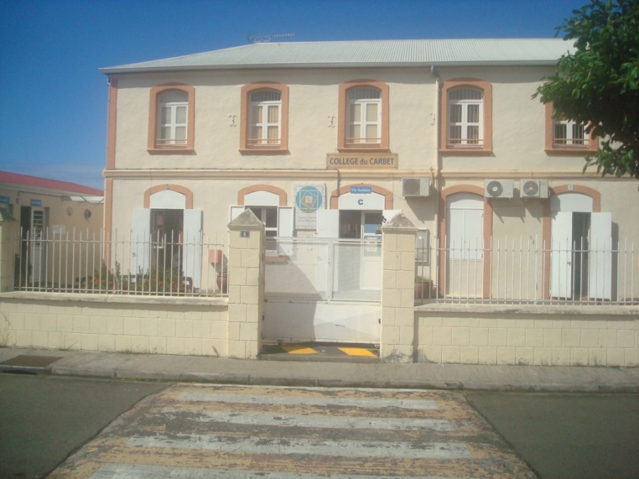
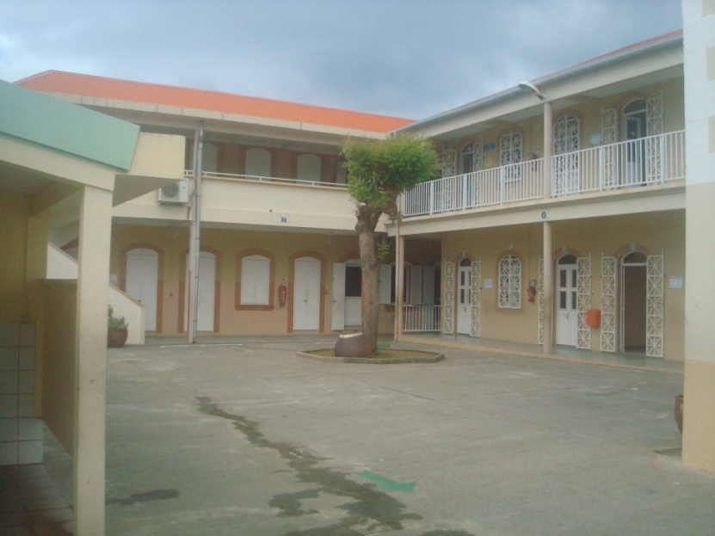
Le collège du Carbet
Le collège du Carbet compte près de 330 élèves âgés de 11 à 15 ans. Il est constitué de deux parties : le bâtiment principal et l’annexe.
The Carbet secondary school has about 3 students between 11 and 15 years old. It consists of two parts: the main building and the annex.
Le bâtiment principal
L’annexe

Slide 10
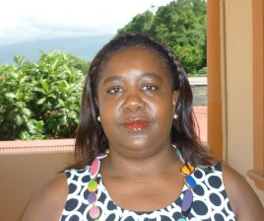
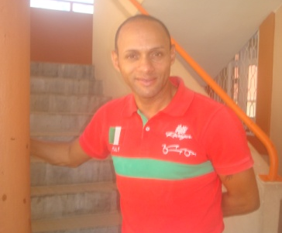
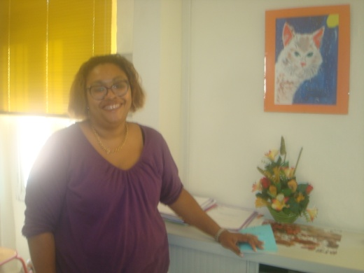
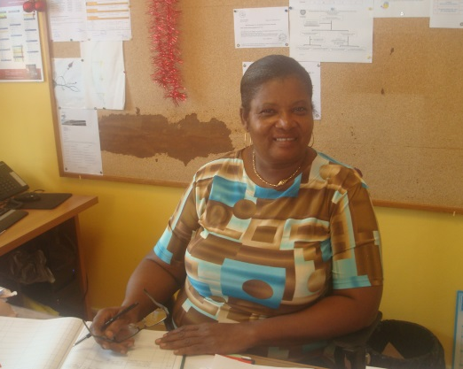
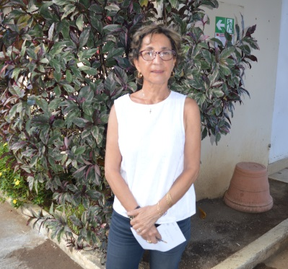
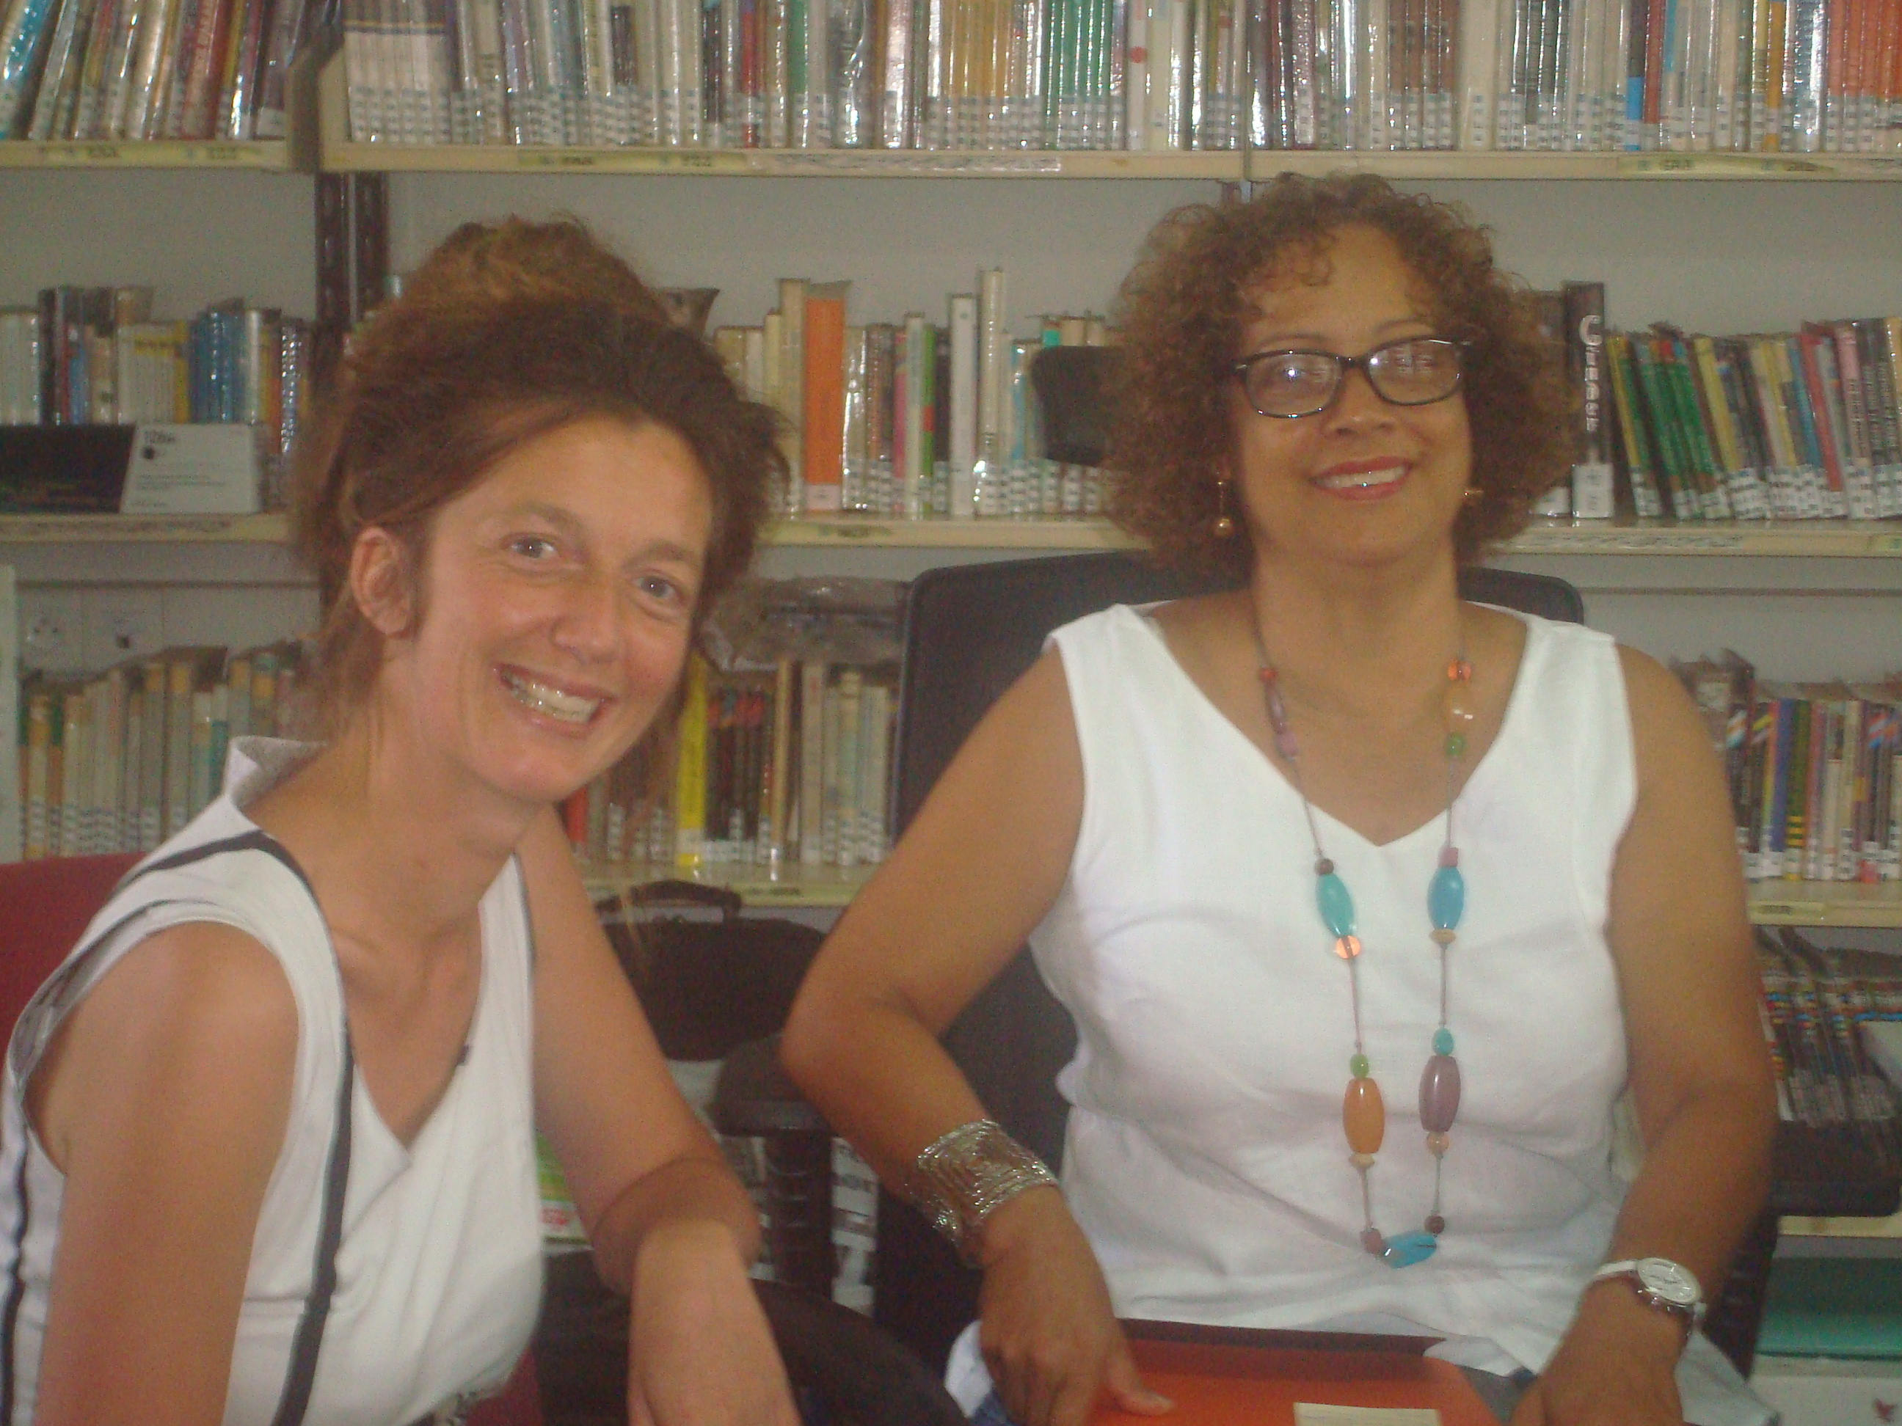

Administration staff
M. Jean-Charles, the education advisor.
Le conseiller principal d’éducation.
Mme Pain, the manager’s assistant.
La secrétaire de gestion.
Mme Frontier, the nurse.
L’infirmière.
Mme Annie Barège, the headteacher.
La Principale.
Mme Casimirius, the head’s secretary.
La secrétaire de direction.

Slide 11
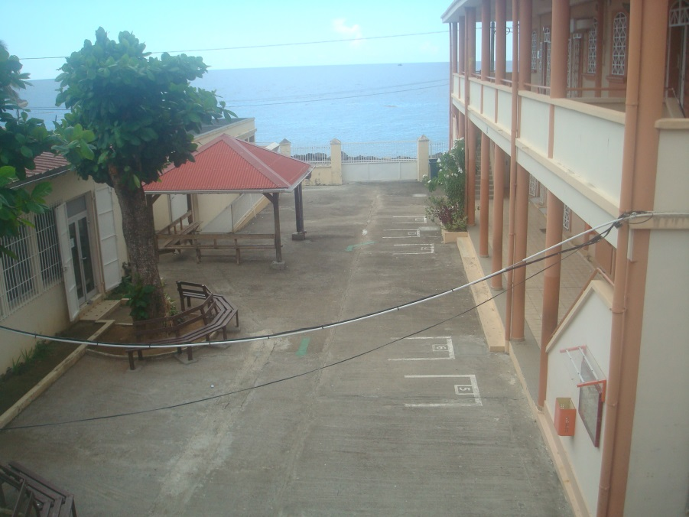
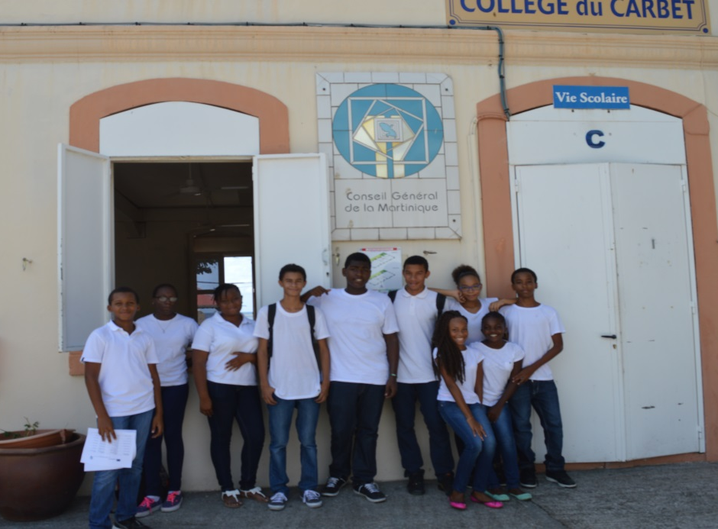
School life
Nous avons le même calendrier scolaire qu’en France métropolitaine. L’école commence vers le 1er septembre et finit début juillet.
We have the same school calendar as in mainland France. School starts around the September 1st and finishes in early July.
Les cours commencent à 7h30 et finissent à 17h00. Nous portons un uniforme: le jeans bleu avec un T-shirt blanc.
Classes start at 7:30 am and finish at 5:00 pm. We wear uniforms -blue jeans with white T-shirts.

Slide 12
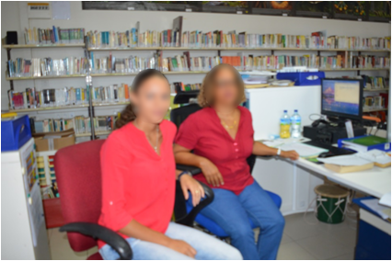
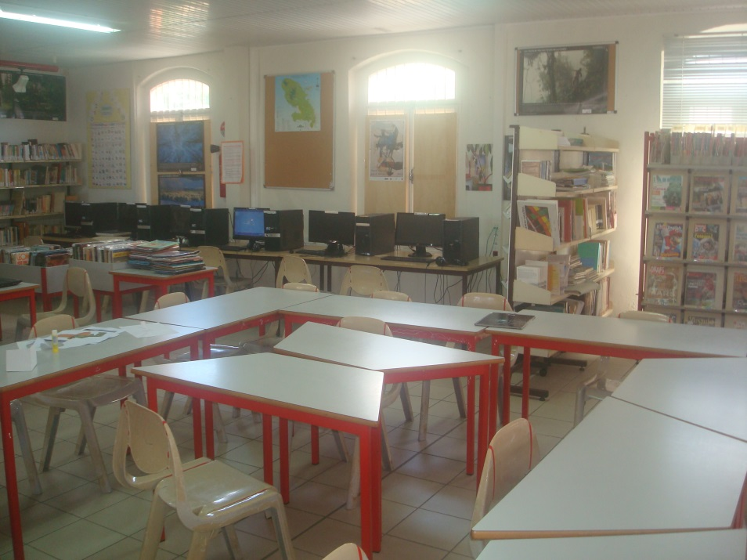
C D I/ School library
Le C D I (Centre de Documentation et d’Information) est la bibliothèque du collège. C’est un espace de lecture et de travail et de recherches sur Internet. Nous y trouvons de nombreux renseignements sur les métiers.
The school library is a space to study, read and do some research in books, magazines or on the Internet. We can find a lot of information on jobs and careers too.
On the left: Linda, the assistant.
On the right: Mme Lorto, the librarian. Le professeur documentaliste.

Slide 13
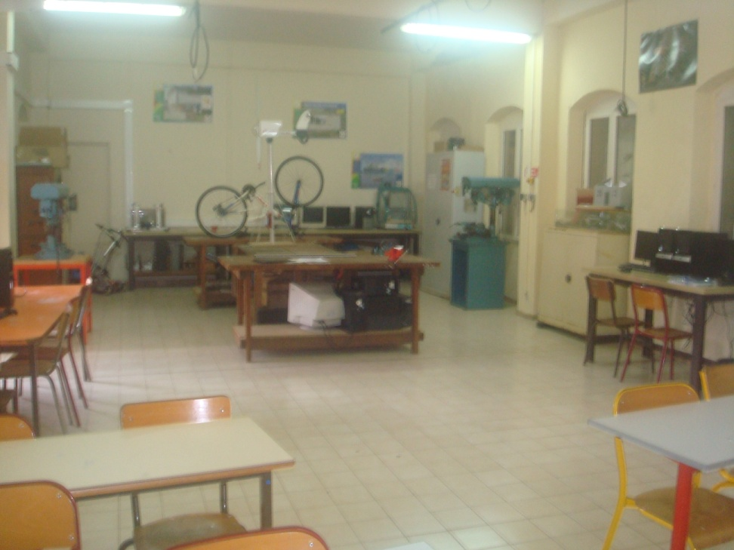
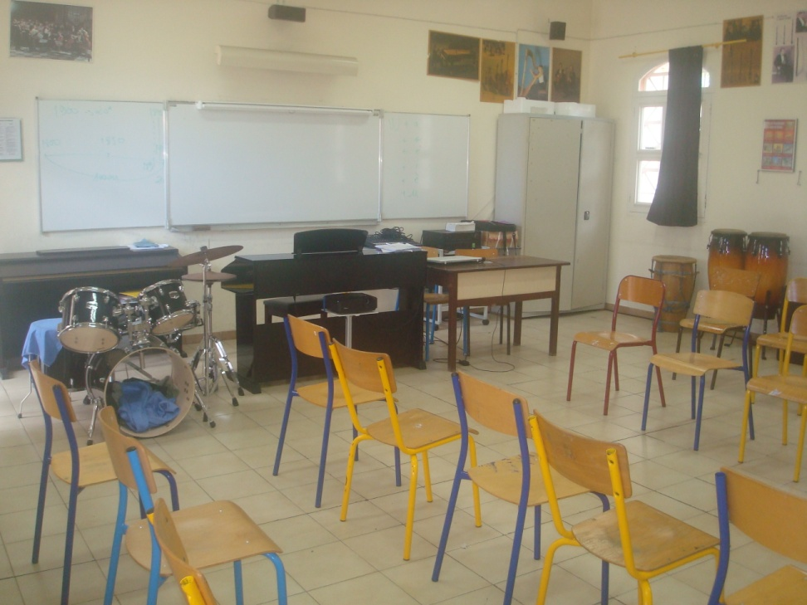
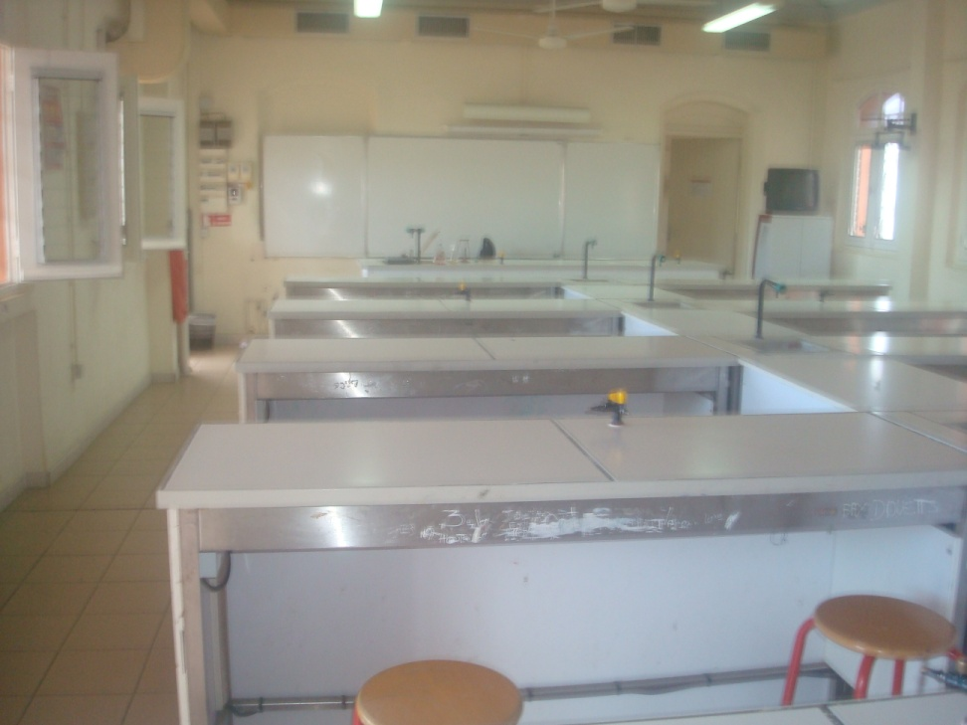
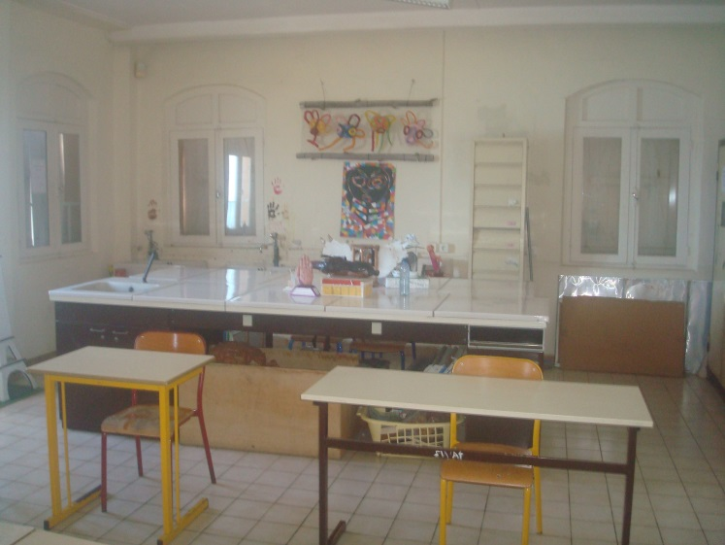
School equipments
La salle de technologie.
The Information Technology room.
La salle de musique.
The music room where our teacher M. Adin prepares us to mini concerts.
La salle de sciences physiques.
The physics and biology room.
La salle d’arts plastiques.
The plastic arts room.

Slide 14
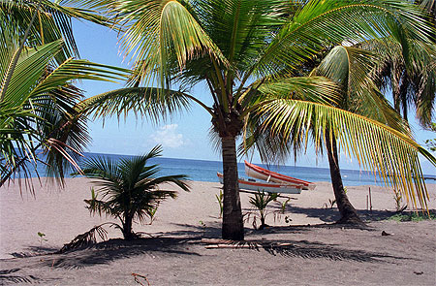
Are you ready for the quiz?
1) Where is Martinique ?
Martinique is an island located in the south of Dominica and in the north of St-Lucia.
It is in the south of France.
it is in the north of Cuba.
2) Where is Carbet ?
Carbet is in the south of Martinique on the Caribbean coast.
It is in the north of Martinique on the Atlantic coast.
It is in the north of Martinique on the Caribbean coast.
3) What is the capital city of Martinique?
Carbet
Pointe-à-Pitre
Fort-de-France

Slide 15
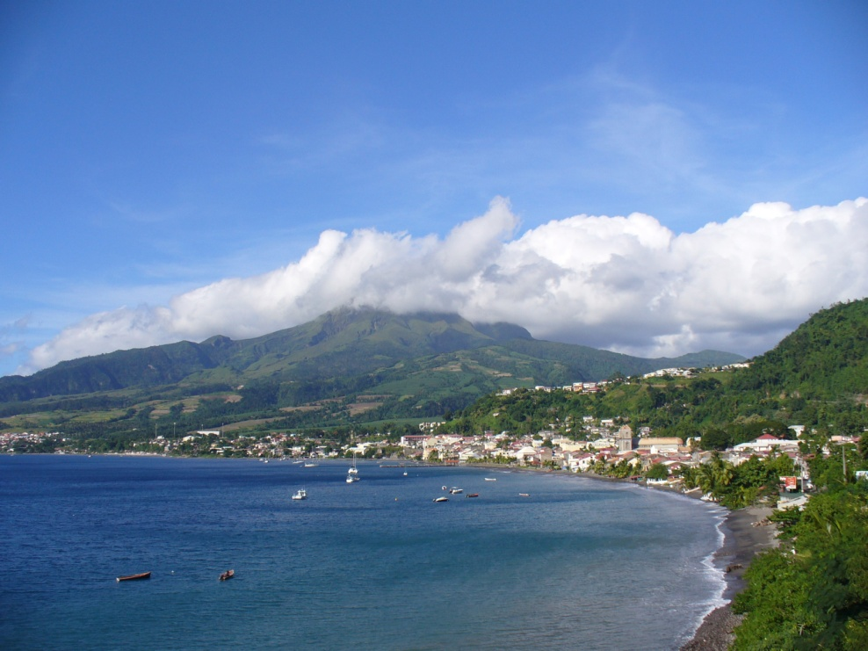
4) How many people are there in Martinique?
about 4000
about 40 000
about 400 000
5) What type of food is produced in Carbet?
Chocolate, sweets and biscuits
Fruit, vegetables, fish and Neisson rum
Toys and cars
6) How many students are there in the Carbet secondary school?
330 students
455 students
530 students

Slide 16
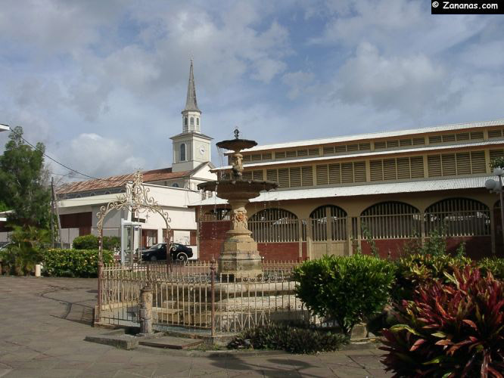
7) What time do the classes start in the Carbet secondary school?
At 7 o’clock am
At 7:30 am
At 8:00 am
8) Where can you do research about jobs and careers?
In the music room
In the Information Technology room
In the « CDI » (school library)
9) When does the school year start and end in Martinique?
On September 1st until July 3rd
On September 15th until end of June
On October 1st until May

Slide 17
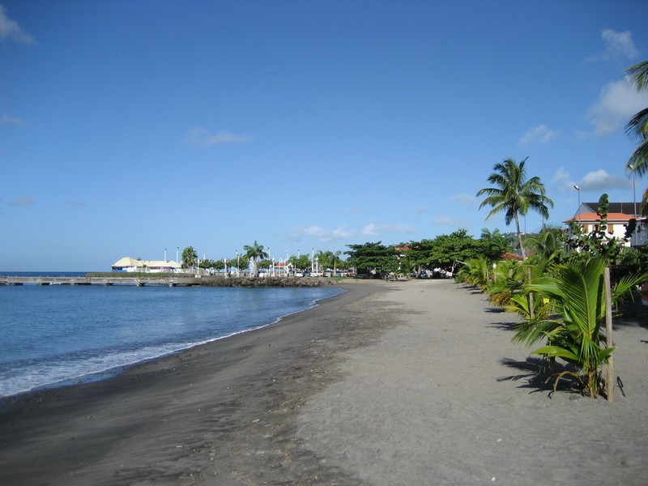
10) Who discovered Martinique and arrived in Carbet in 1502?
M. Jean-Charles
Christopher Colombus
M. Lorto
Thank you for participating and see you soon in Carbet!!
A bientôt au Carbet!!
An lot soleil!!

